Slide 1
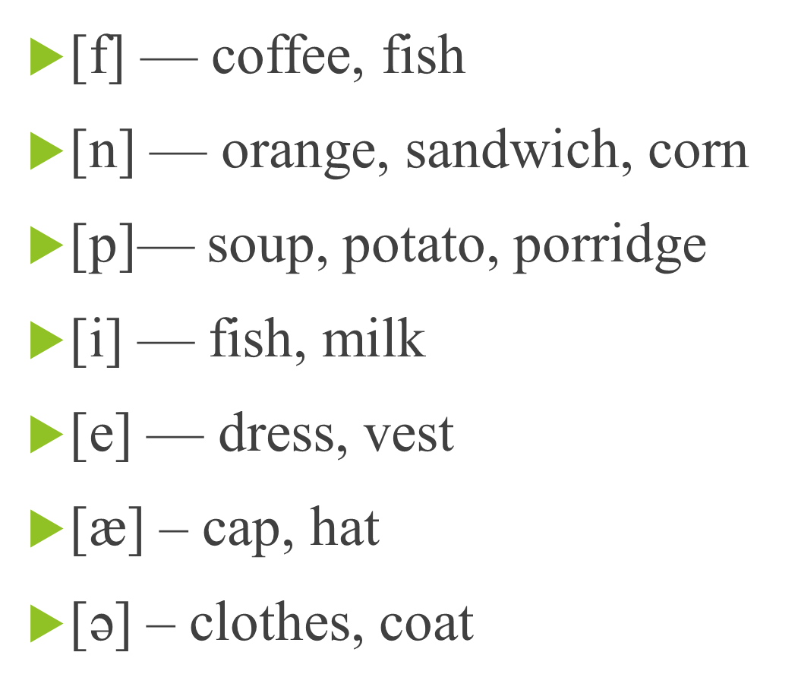

Slide 2
Shop and shopping

Slide 3
«The quickest way to know a woman is to go shopping with her. »
Marcelene Cox.
«Самый быстрый способ узнать женщину — это пойти с ней по магазинам.»
Марселин Кокс.

Slide 4
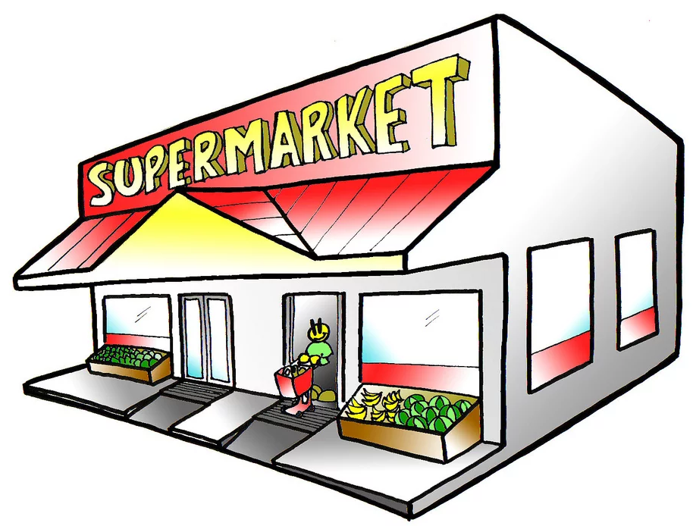

Slide 5
Discuss the proverbs
Never buy a pig in a poke. | Чем больше имеешь, тем больше хочется.
Waste not, want not. | Никогда не трать деньги, пока их не заимел.
The more you have, the more you want. | Никогда не покупай свинью в мешке.
The worth of a thing is best known by the want of it. | Умеришь расходы – не будешь нуждаться
Never spend your money before you have it. | Ценность вещи познается тогда, когда она нужна, а ее нет.

Slide 6
a. shopping | 1. There is … department in this shop where you can buy perfume.
b. cosmetic | 2. You can come to the …and choose your purchase.
c. things for sale | 3. In our greengrocer’s you can buy… vegetables.
d. basket | 4. You pay money to the… .
e. clothes | 5. You can … food and put it into the … .
f. counter | 6. She does the … in their family.
g. in fashion | 7. I enjoy going shopping for new … .
h. ready-weighed and packed | 8. They spend quite a lot of maney on … .
i. select | 9. I don’t feel … in these shoes.
j. cashier | 10. I always try to be … .
k. food
l. comfortable
m. quality

Slide 7
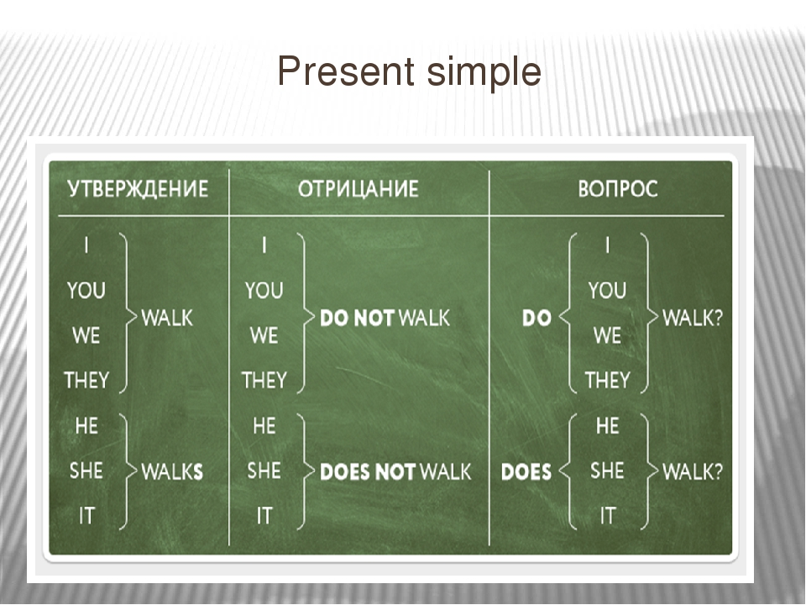

Slide 8
1. I (to work) in a bank. 2. He (to live) in Moscow. 3. Anna (to have) a shower every day. 4. I (to like) flowers. 5. They (to go) at work by bus. 6. Tom (to play) the piano. 7. Cats (to drink) milk. 8. She (to get up) early. I (to love) you. Kristina and Mike (to study) English.

Slide 9
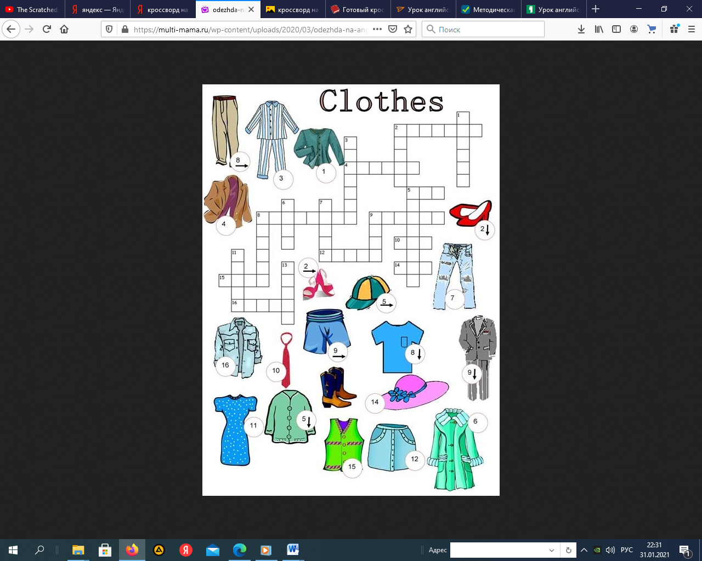

Slide 10
d | a | i | r | y | y | m | p | r | u
q | k | w | x | b | j | f | o | o | d
w | u | s | e | u | h | n | q | f | m
d | l | s | d | t | n | e | a | v | g
f | o | h | c | c | u | y | z | t | r
c | l | o | t | h | e | s | w | g | o
t | q | p | r | e | j | i | s | b | c
t | s | p | f | r | m | k | x | y | e
o | z | i | v | s | i | o | d | h | r
y | q | n | t | b | a | k | e | r | s
s | a | g | g | b | s | h | o | p | u

