Slide 1
КОНКУРС ЗНАТОКОВ ИНОСТРАННОГО ЯЗЫКА

Slide 2
When is Halloween celebrated in the UK?
a) on 31st October b) on 31st November
c) on 31st September d) on 31st January
When is Queen`s birthday celebrated?
a) on 20 th June b) on the 21st April
c) on the 25th December d) on the 20th April

Slide 3
What is London residence of Queen Elizabeth II?
a) the Tower of London b) Winsdor Castle
c) Buckingham Palace d) Westminster Abbey
The Princess Diana was the wife of …
a)Prince John b) Prince Robert
c) Prince Wilhelm d) Prince Charles

Slide 4
What is the symbol of the United Kingdom?
a) a bald eagle b) Britannia
c) a rose d) a leek
What is the name of the British national flag?
a) the Union Jack b) the Saint Andrew’s Cross
c) the Saint David’s Cross d) the Stars and Stripes

Slide 5
What is the official religion in the United Kingdom?
a) Catholicism b) Orthodoxy
c) Protestantism d) Judaism
What is the emblem of Scotland?
a) a daffodil b) a thistle
c) a dragon d) a red rose

Slide 6
What two animals can we see on British royal coat of arms?
a) the lion and the fox b) the lion and the elephant
c) the lion and the unicorn d) the lion and the wolf
What is the longest river in Great Britain?
a) the Severn b) the Avon
c) the Thames d) the Tyne

Slide 7
Great Britain is divided into… .
a) 2 parts b) 3 parts c) 4 parts d) 5 parts
What is the population of the UK?
a) 123 000 people b) 45 million people
c) 5 million people d) 145 million people
What is the most popular drink in Britain?
a) apple juice b) tea c) milk d) coffee

Slide 8
What do children usually say at Halloween?
a) “trick or treat” b) “sing or dance”
c) “give or take” d) “cry or laugh”
Which holiday is usually celebrated on the 5th of November in the UK?
a) Easter b) Guy Fawkes Day
c) Halloween d) New Year
Who discovered America?
a) Christopher Columbus b) the pilgrims
c) George Washington d) Amerigo Vespucci

Slide 9
What is the capital of New York State?
a) Washington b) New York
c) Albany d) Los Angeles
In which month is Thanksgiving Day celebrated?
a) December b) February
c) November d) March
America celebrates it on the 4th of July.
a) St.Valentine`s Day b) Thanksgiving Day
c) Independence Day c) Mother`s Day

Slide 10
Who was the first president of the USA?
a) A.Lincoln b) F.D.Roosevelt
c) George Washington d) Bill Clinton
The first university in America was…
a) Boston b) MIT Cambridge
c) Harvard d) Oxford
The American flag has…
a) 13 stripes b) 50 stripes
c) 30 stripes d) 51 stripes

Slide 11
What is the national sport in America?
a) baseball b) soccer
c) football d) basketball
Where are the British kings crowned?
a) in Parliament Square b) in St. Paul’s Cathedral
c) in Westminster Abbey d) in Canterbury Cathedral
What city in Britain has nickname “The Smoke”?
a) Edinburgh b) Cardiff c) London d) Aberdeen

Slide 12
Washington D.C. is…
a) a state b) a district
c) a county d) an island
Elvis Presley was known as the «King of…”
a) Jazz b) Heavy metal
c) Rock-n-roll d) Pop music

Slide 13
1. Score twice before you cut once.
1. Семь раз отмерь — один раз отрежь.
2. Fortune favors the brave.
2. Надеяться на удачу.
3. East or West — home is best.
3. В гостях хорошо, а дома лучше.
4. To beat the air.
4. Вертеться на языке.
5. Live and learn.
5. Век живи — век учись.
6. As red as a cherry.
6. Кровь с молоком.

Slide 14
7. Every cook praises his own broth.
7. Каждый кулик свое болото хвалит.
8. Keep your chin up.
8. Не вешай носа.
9. All's well that ends well.
9. Все хорошо, что хорошо кончается.
10. Tastes differ.
10. О вкусах не спорят.
11. Rome was not built in a day.
11. Москва не сразу строилась.
12. Curiosity killed the cat.
12. Без труда не вынешь рыбку из пруда.

Slide 15
13. Keep one's fingers crossed.
13. Любопытной Варваре на базаре нос оторвали.
14. Better late than never.
14. Лучше поздно, чем никогда.
15. A friend in need is a friend indeed.
15. Друг познается в беде.
16. Wishes don't wash dishes.
16. Толочь воду в ступе.
17. As hungry as a hunter.
17. Голоден, как волк.
18. My home is my castle.
18. Мой дом — моя крепость.

Slide 16
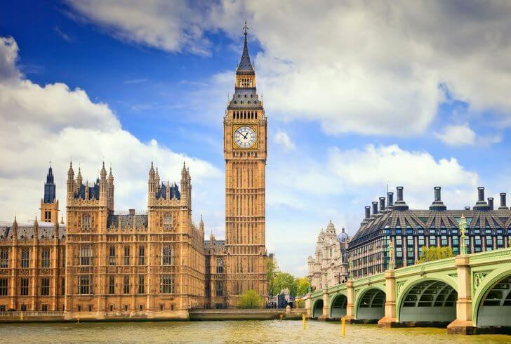

Slide 17
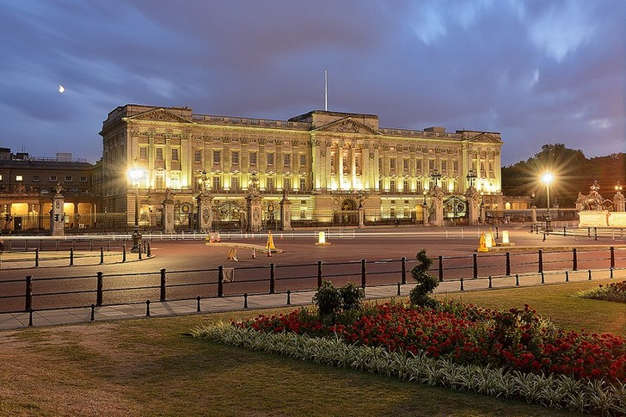

Slide 18
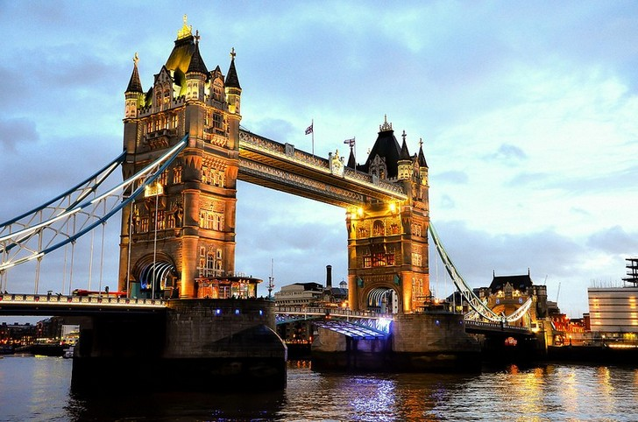

Slide 19
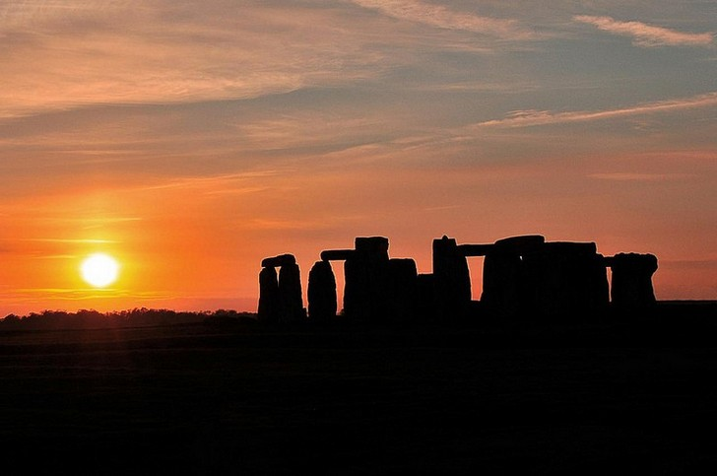

Slide 20
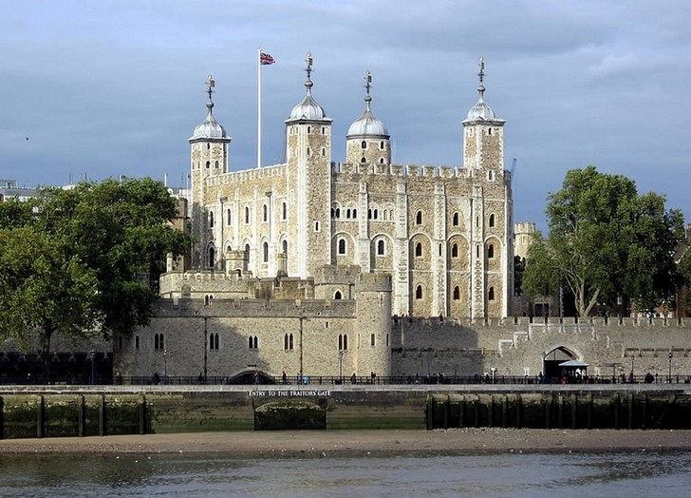

Slide 21
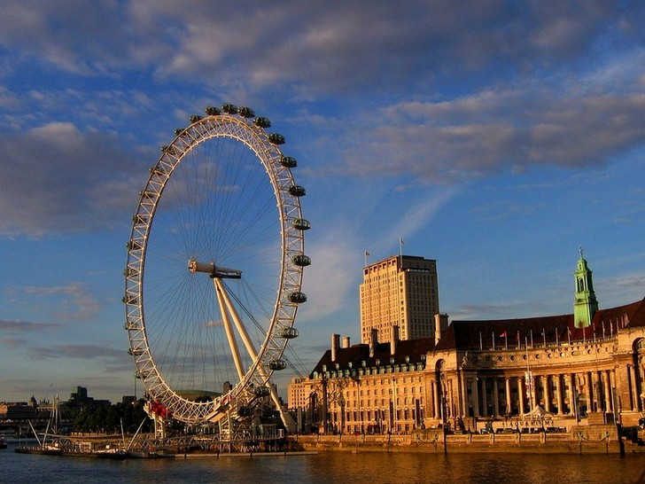

Slide 22
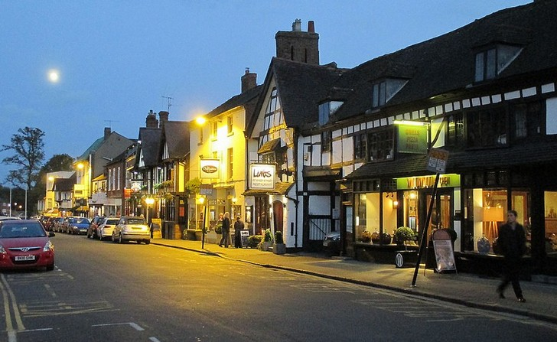

Slide 23
A | E | T | B | I | G | B | E | N | C | Q | A
I | N | V | M | I | S | Q | W | R | Y | U | O
H | G | D | O | H | C | A | P | I | T | A | L
K | L | O | N | D | O | N | P | A | O | S | E
W | A | L | E | S | T | G | H | K | W | L | N
Z | N | X | C | C | L | V | B | Q | E | N | G
M | D | Q | I | W | A | E | R | U | R | Y | L
U | I | O | T | A | N | S | F | E | G | H | I
K | L | Z | Y | X | D | C | V | E | B | N | S
M | Q | B | R | I | T | A | I | N | E | T | H

Slide 24
Most people in Britain and the USA celebrate _______on 25th December.
People believe that Santa gives presents to good children but naughty children usually receive only a piece of _____.
The traditional Thanksgiving dish in the USA is _____.
The most popular vegetable on Halloween is carved ______.
______ is one of the most favorite holidays in the USA except Christmas.

Slide 25
“Trick or treat?” is the most popular phrase on _______.
The guest who comes to somebody’s home after the midnight on the New Year is called as ___.
On 4th July we can see lot of _____ in American cities and towns.
On 17th March (St. Patrick’s Day) the Potomac River is painted in ______.
Every third Monday of February Americans celebrate ______.

