Slide 1



Slide 2

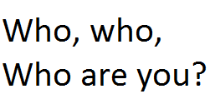



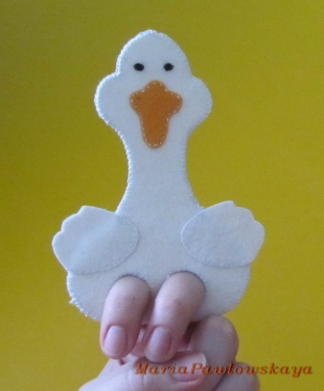
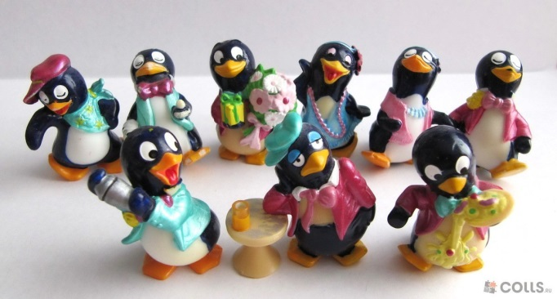
What, what,
What is in the pot ?
Where, where,
Where is my chair?
When, when,
When do we use a pen?
Whose, whose,
Whose is this goose?
Why, why,
Why don't the penguins fly?

Slide 3
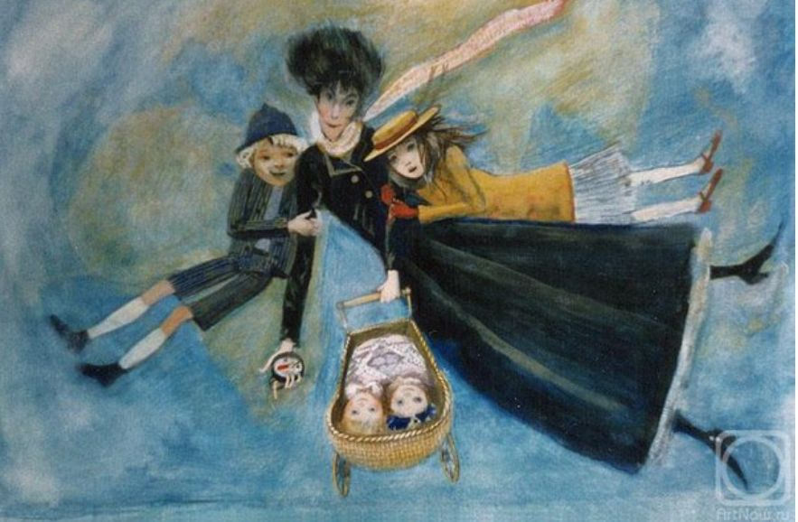

Slide 4

funny happy worried glad
tree house grass river
biscuit cake bread milk

Slide 5
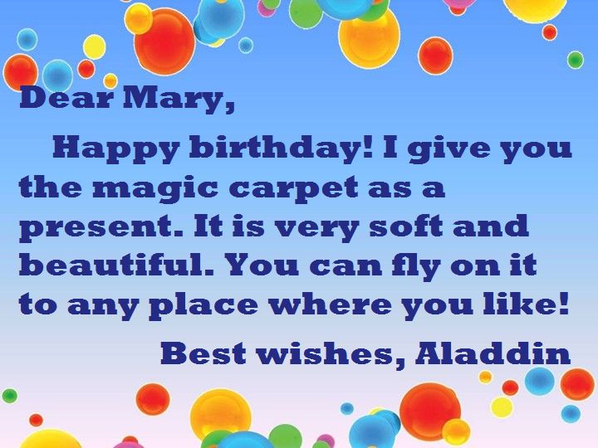
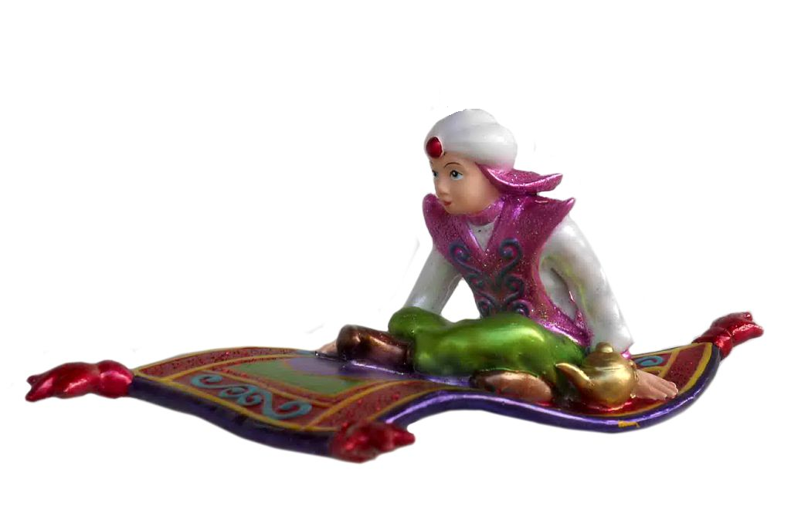
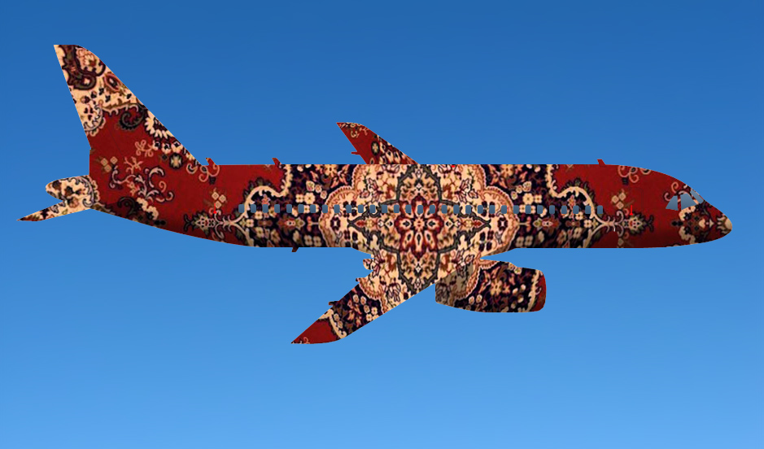

Slide 6
Good bye!

