Slide 1

THE CHRISTMAS QUIZ

Slide 2
1. Who is a large, plump man dressed in red?

Slide 3
2. Where does Santa Claus live?
A New York
B The North Pole
C Island

Slide 4
3. How many reindeer does Santa have?
A 7
B 12
C 9

Slide 5
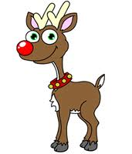
4. Can you name all the reindeer?

Slide 6
5. What are the two most popular Christmas colours?
A blue and pink
B yellow and green
C red and green

Slide 7
6. What type of plant is used to decorate at Christmas?

Slide 8
7. How many Christmas songs can you name?

Slide 9
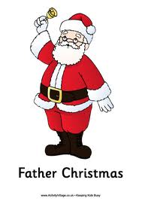
8. What transport does Santa use?
A: a car
B: a sleigh
C: a bobsleigh

Slide 10
What night does Santa come?
A: 24 December
B: 25 December
C: 26 December

Slide 11
10. What do Children hang up for Santa to put the toys in?
A: a box
B: a bag
C: a stocking

Slide 12
11. WHAT AM I?
I grow in the forest but I come into people’s houses at Christmas.

Slide 13
12. WHAT AM I?
I come in many colours and I need electricity to work.

Slide 14
13. WHAT AM I?
Everybody likes to receive me.

Slide 15
14. WHAT AM I?
Father Christmas wears me on his head.

Slide 16
15. WHAT AM I?
People eat me in the UK for Christmas dinner.

