Slide 1
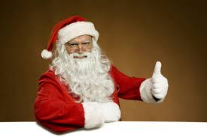
CHRISTMAS QUIZZ
Are you ready to start??

Slide 2
Christmas Eve is on….
24th. December
24th. January
25th. December

Slide 3
In New Zealand for Christmas we eat..
a)Roast turkey and vegetables
b)Prawns and fish
c)Duck and soup

Slide 4
The name of the red nose reindeer is…
Rudolph
Dancer
Prancer

Slide 5
In the U.K for Christmas it is…
Hot and warm
Hot and cold
Cold and snowy

Slide 6
The mistletoe is …
a Christmas plant
a Christmas present
a Christmas decoration

Slide 7
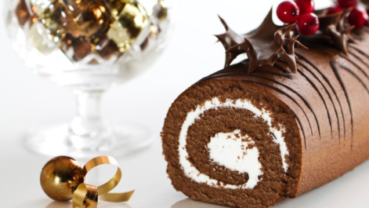
A Yule log is …
a Christmas dessert
a Christmas present
a Christmas decoration

Slide 8
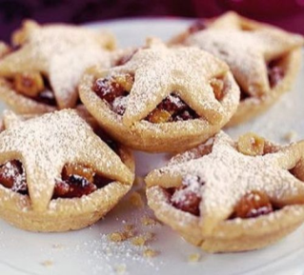
Mince pies are…
pies filled with chocolate
sweet pies with apples
small round tarts containing sweet mincemeat

Slide 9
The special Christmas poultry is …
Chicken
Turkey
Goose

Slide 10
We hang up……….. by the chimney
Wreath
Stockings
Presents

Slide 11
HO, HO, HO….
ANSWERS
2.A
3.B
4.B
5.A
6.C
7.A
8.A
9.C
10.B
11.B

Slide 12
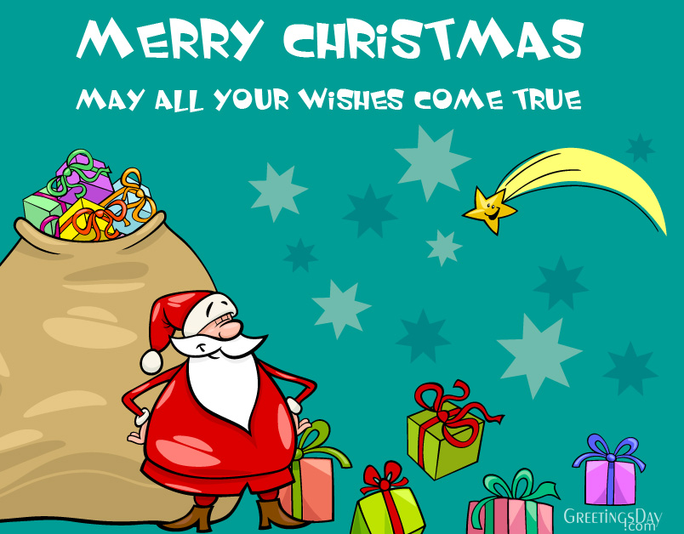
https://www.youtube.com/watch?v=BXUUoO6JUH4

