Slide 1
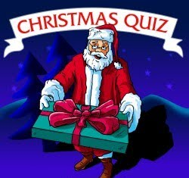

Slide 2
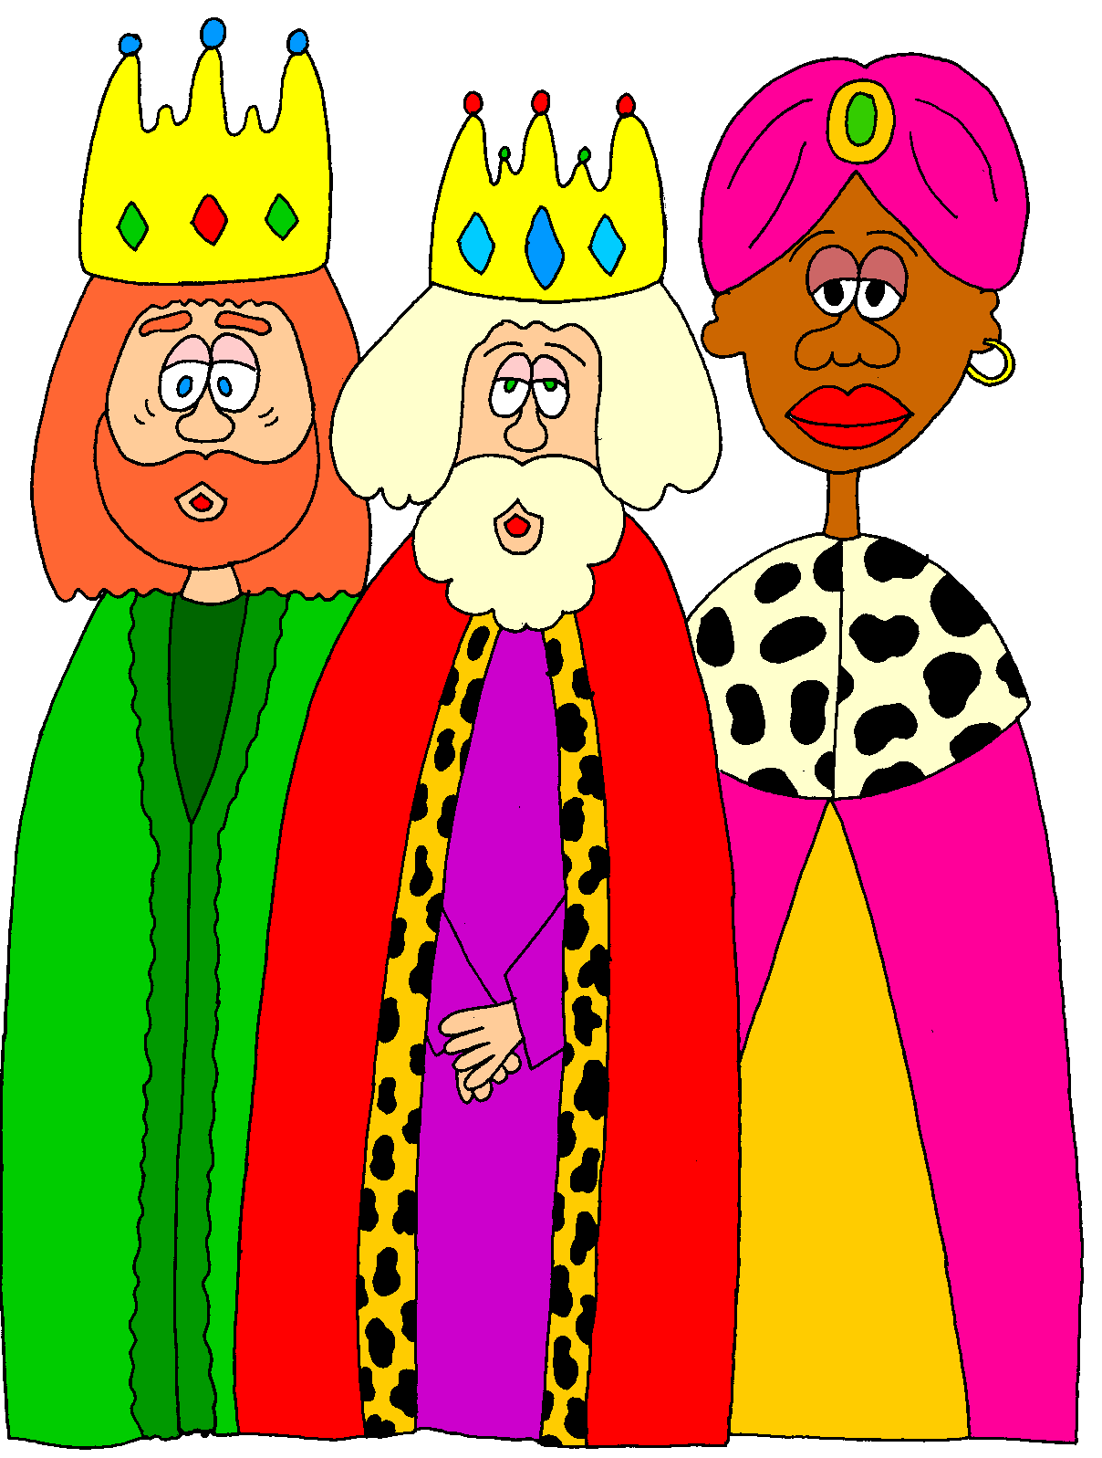
The three … men bring presents to kids on 6th January.
a) Wise
b) Good
c) Nice
d) Kind
A) WISE

Slide 3
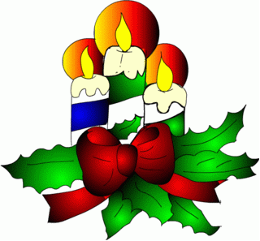
You burn it to give light. It’s also used as an ornament.
a) Bulb
b) Match
c) Candle
d) Torch
C) candle

Slide 4
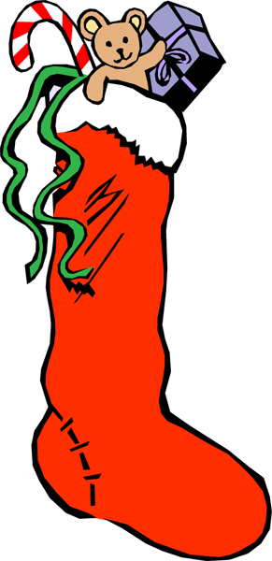
Children hang them by the fireplace on Christmas Eve.
a) Pants
b) Bags
c) Jeans
d) Stockings
d) stockings

Slide 5
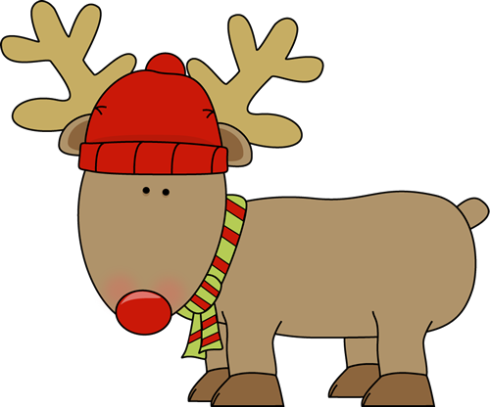
Animal that pulls Santa’s sleigh on the snow.
a) Wolf
b) Ox
c) Reindeer
d) Goat
C) REINDEER

Slide 6
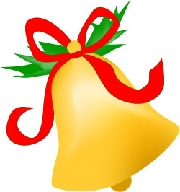
They are made of metal and make a sound when you shake them.
a) Drums
b) Bells
c) Horn
d) Castanets
B) BELLS

Slide 7
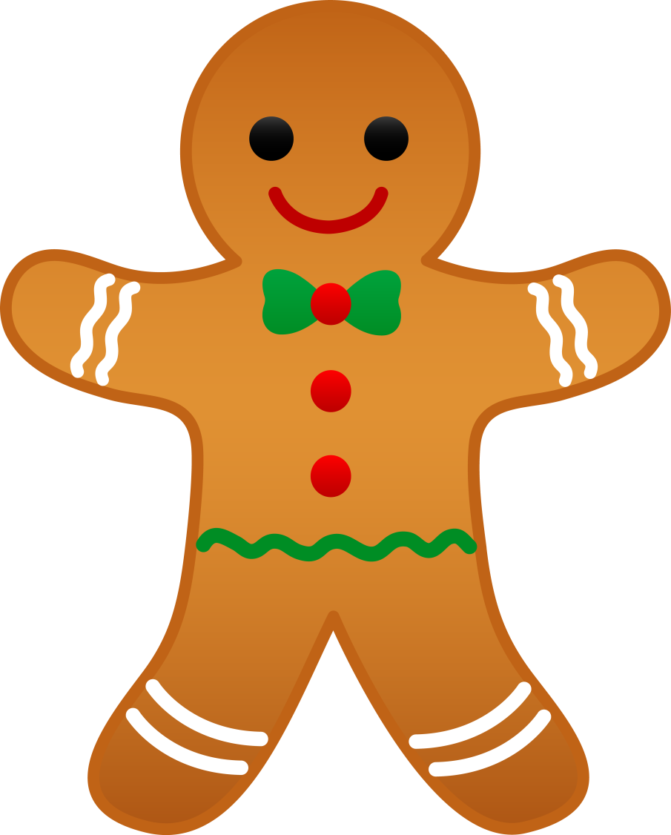
A typical sweet that is eaten at Christmas. It comes in different shapes.
a) Gingerbread
b) Nougat
c) Pudding
d) Lollipop
A) gingerbread

Slide 8
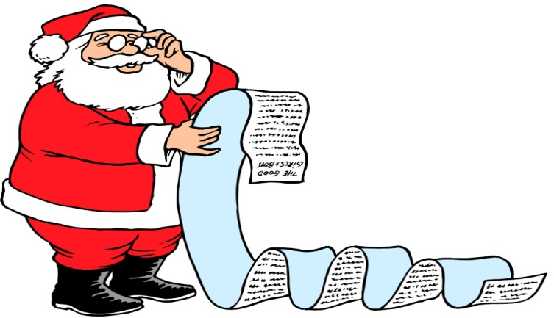
Santa Claus checks it before delivering his presents to the children all over the world.
a) Sleigh
b) Car
c) List
d) Agenda
c) list

Slide 9
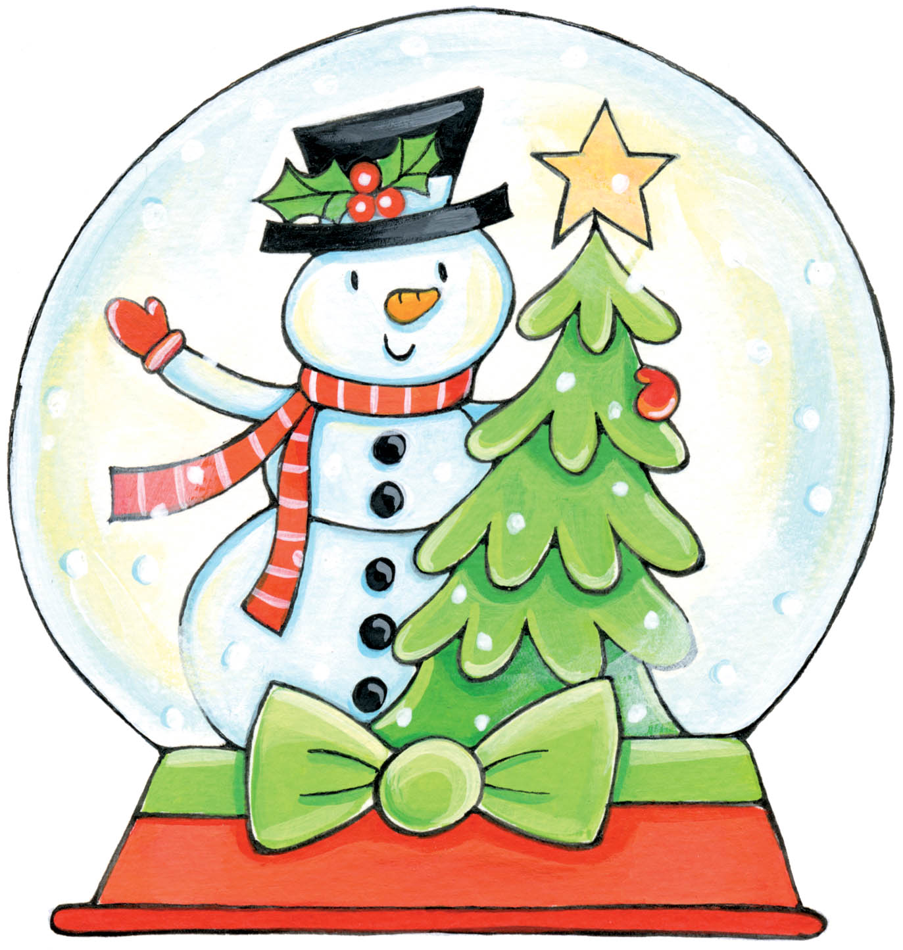
A snow ... is usually made of glass and often has a snowy scene inside it.
a) Ball
b) Man
c) Flake
d) Globe
D) GLOBE

Slide 10
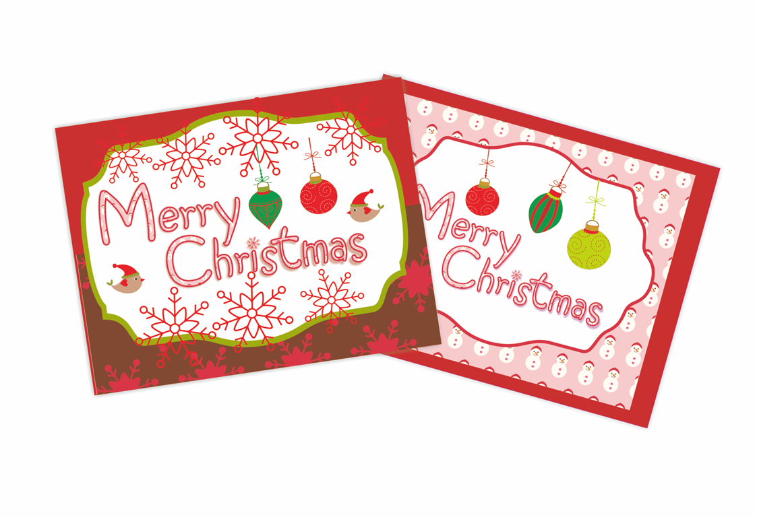
We usually send lots of Christmas
... to our friends and relatives.
a) Cakes
b) Cards
c) Letters
d) Lights
B) CARDS

Slide 11

Santa Claus fills the stockings with them on Christmas Day.
a) Coins
b) Dolls
c) Sweets
d) Bulbs
c) sweets

Slide 12
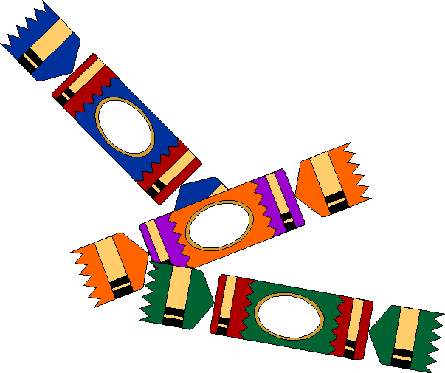
They have a gift and make an exploding sound when you pull them apart.
a) Fireworks
b) Flares
c) Bangers
d) Crackers
D) CRACKERS

Slide 13

It is an ornament which people usually hang on the front door.
a) Ribbon
b) Wreath
c) Figurine
d) Lantern
B) WREATH

Slide 14
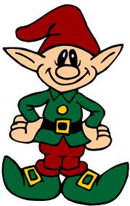
Small creatures whose ears are pointed. They have magical powers.
a) Dwarves
b) Fairies
c) Elves
d) Wizards
c) elves

Slide 15

People decorate the Christmas tree with them.
a) Bulbs
b) Berries
c) Cubes
d) Ties
A) bulbs

Slide 16

It is white and falls from the sky when it is very cold in winter.
a) Hailstone
b) Ice
c) Snowflake
d) Dewdrop
c) snowflake

Slide 17
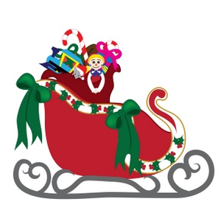
It is the vehicle used by Santa Claus. It is pulled by his reindeer.
a) Cart
b) Sleigh
c) Chariot
d) Wagon
B) sLEIGH

Slide 18
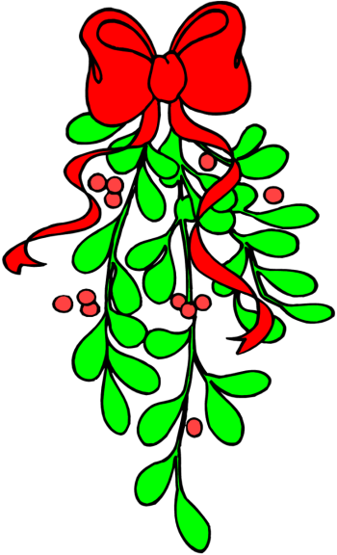
It is a plant and it’s a tradition to kiss people under it.
a) Holly
b) Ivy
c) Fern
d) Mistletoe
d) mistletoe

Slide 19
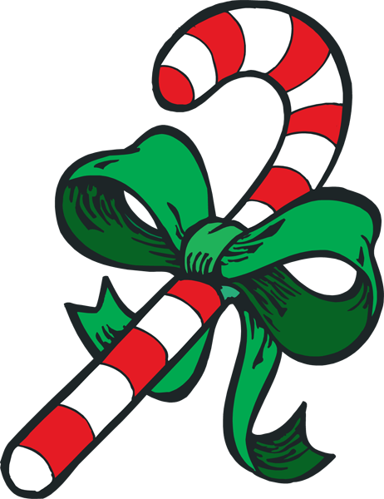
It is a sweet and it usually has red and white stripes.
a) Jelly
b) Bun
c) Candy cane
d) Jam
c) Candy cane

Slide 20
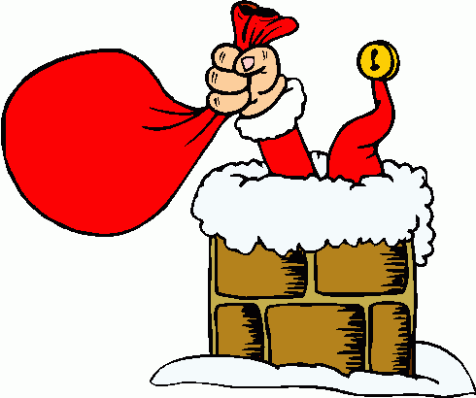
Santa Claus goes down it to deliver his presents on Christmas Eve.
a) Roof
b) Chimney
c) Slide
d) Stairs
B) Chimney

Slide 21

People usually put this ornament on top of the Christmas tree.
a) Bell
b) Star
c) Heart
d) Holly
B) star

Slide 22
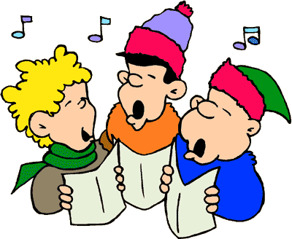
They go door to door singing traditional Christmas songs.
a) Choirs
b) Gospels
c) Carolers
d) Lullabies
c) carolers

Slide 23

People often use one to tie presents so as to make them nicer.
a) Ribbon
b) Wire
c) String
d) Tape
a) ribbon

