Slide 1
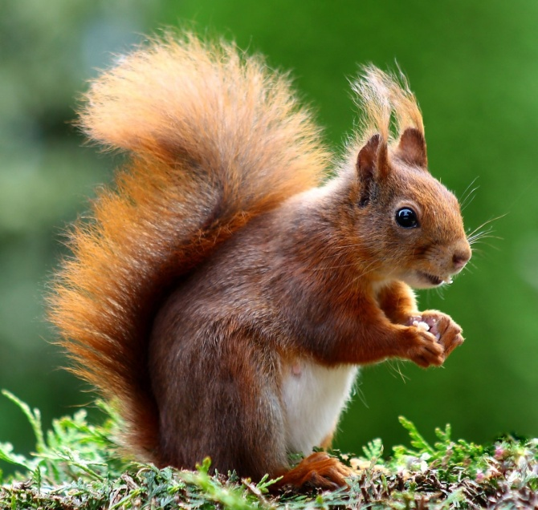
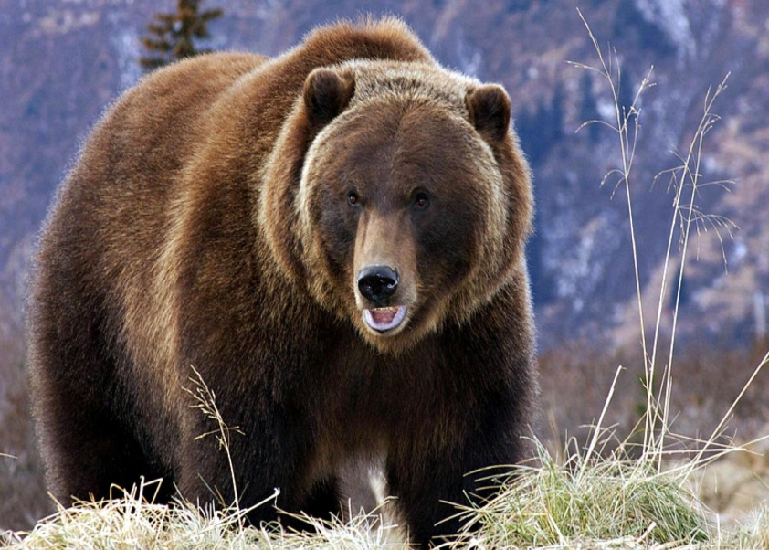
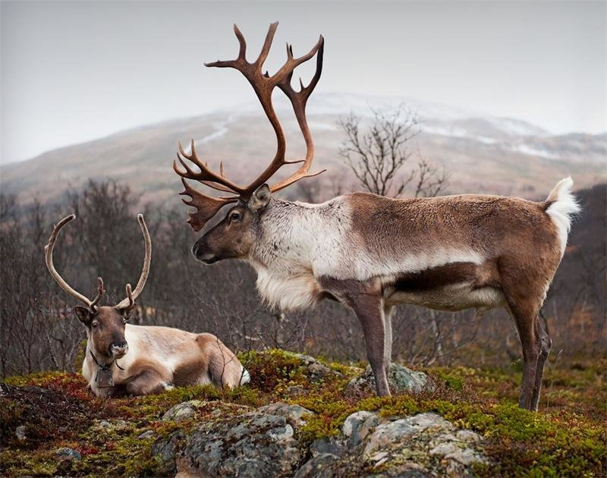
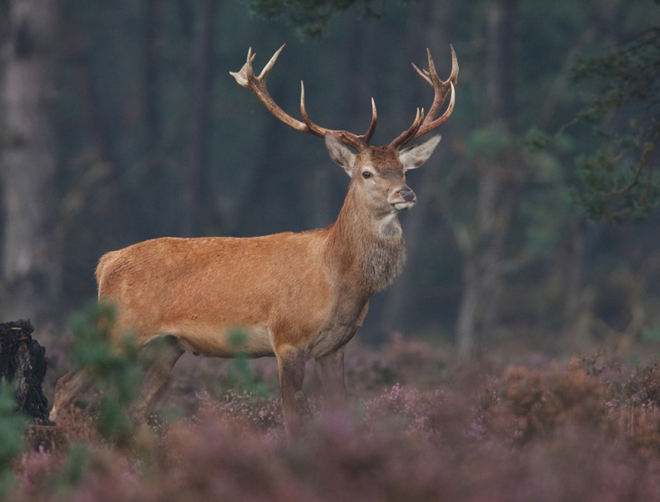
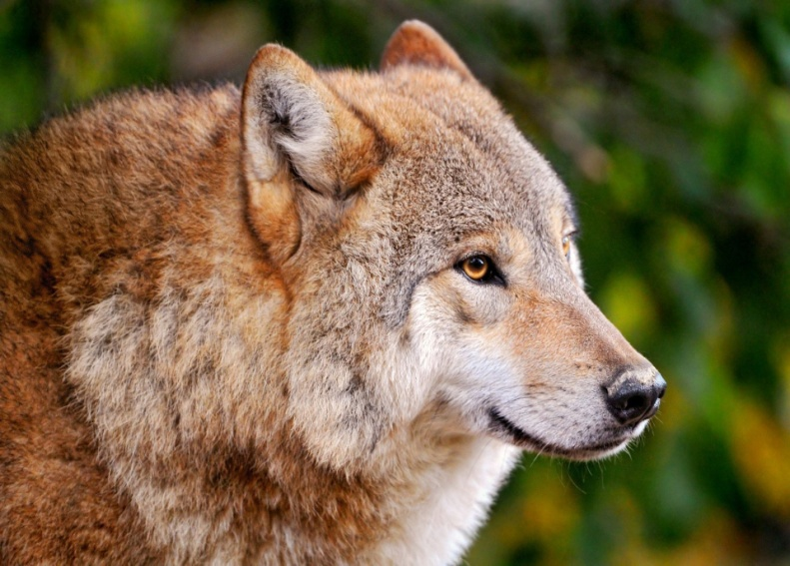
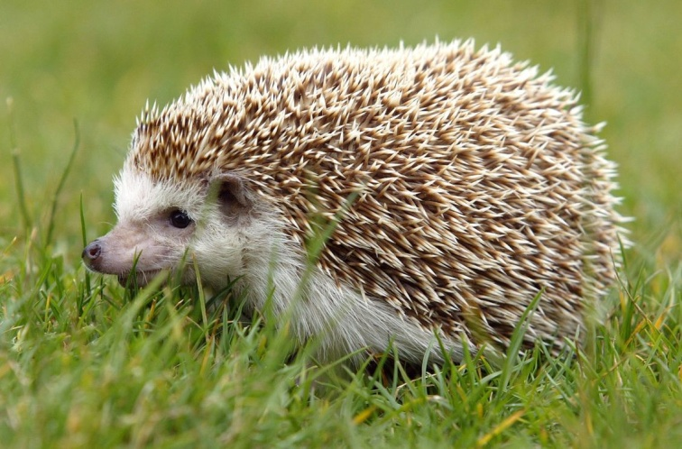
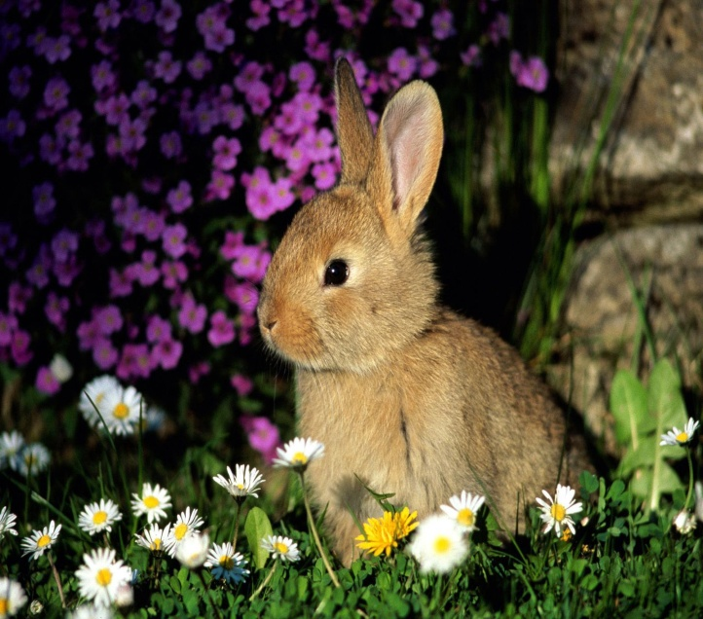
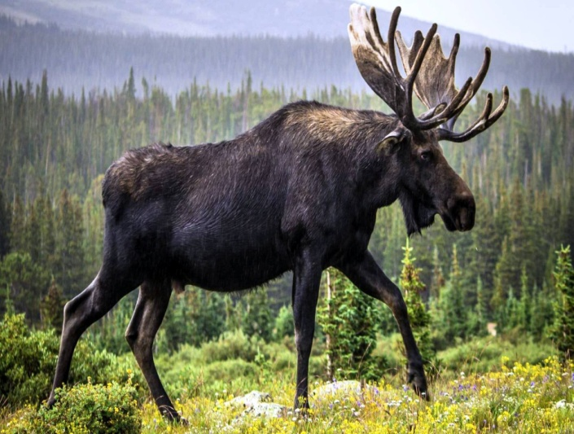
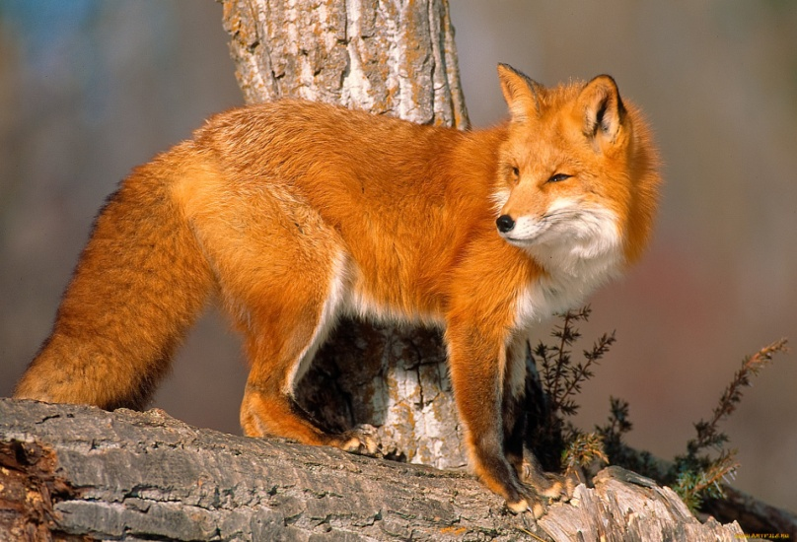

Slide 2
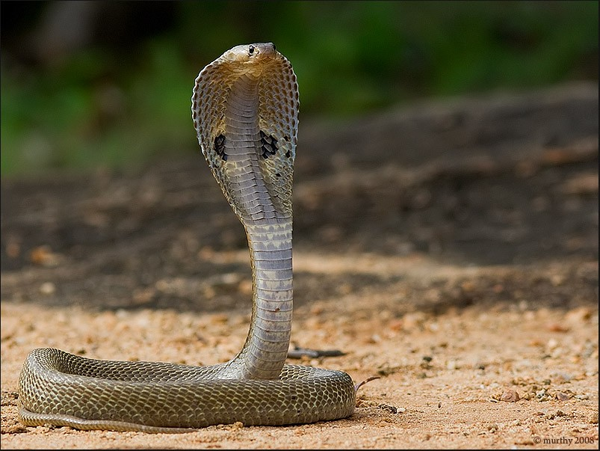
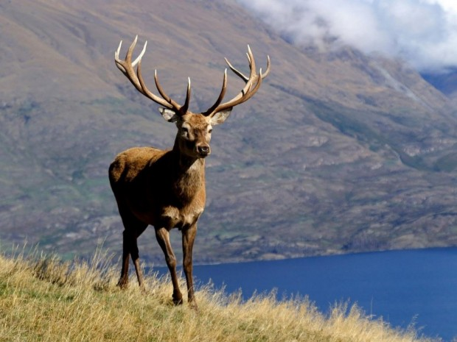
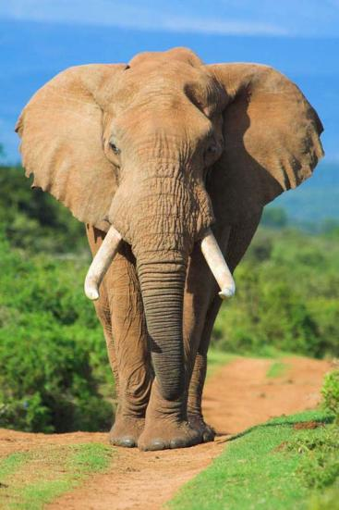
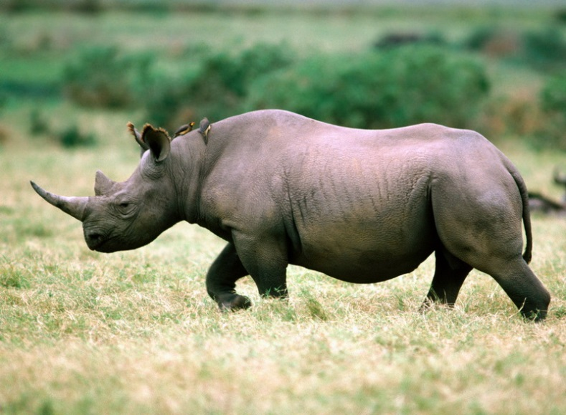
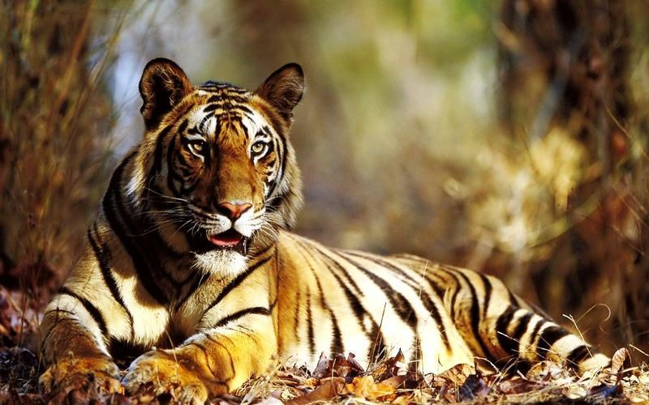
Amazing Animals

Slide 3
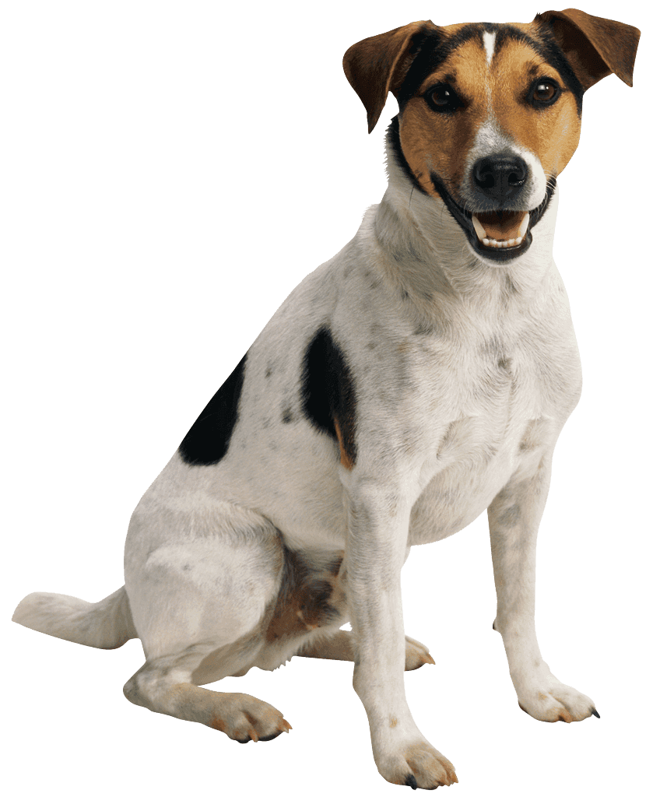
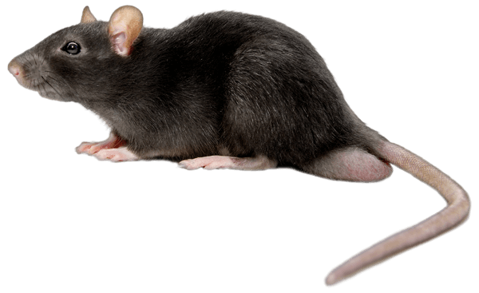
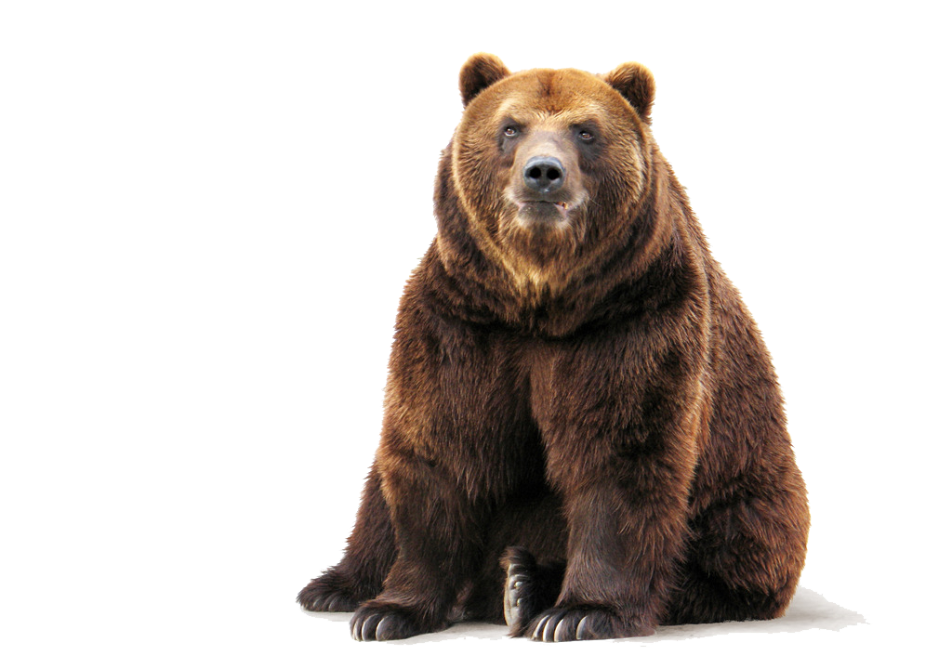
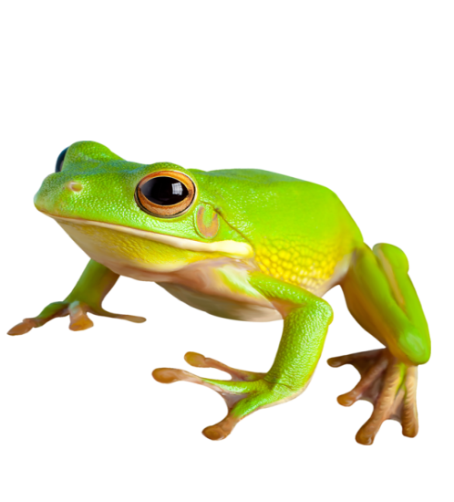
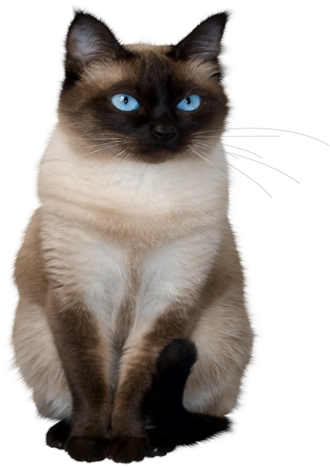
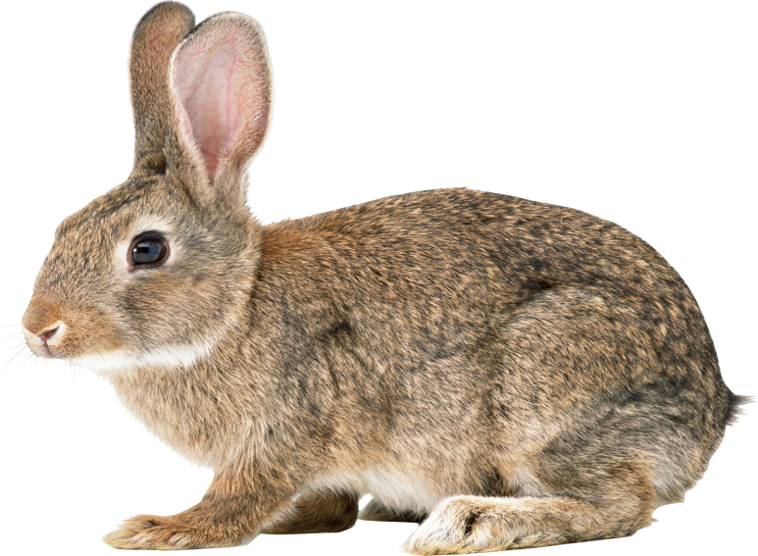
One
Four
Two
Five
Three
Six

Slide 4
One
a rat
Two
a frog
Three
a hare
Four
a dog
Five
a cat
Six
a bear

Slide 5
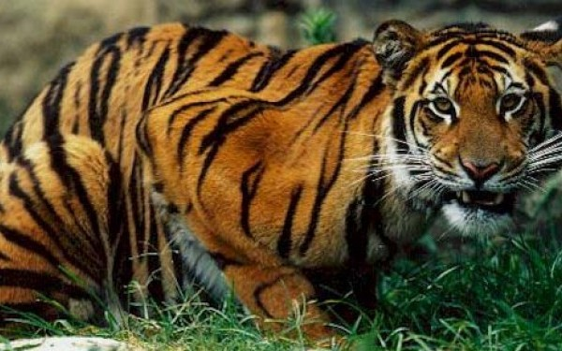
Stripes

Slide 6
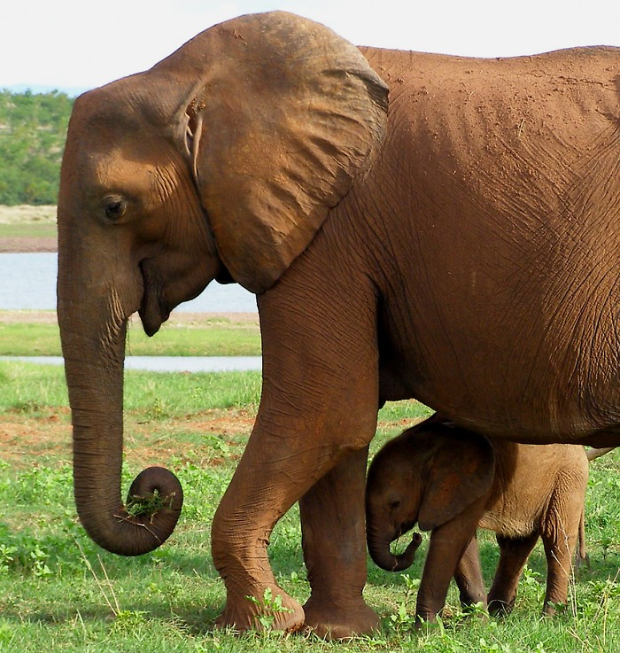
A head

Slide 7
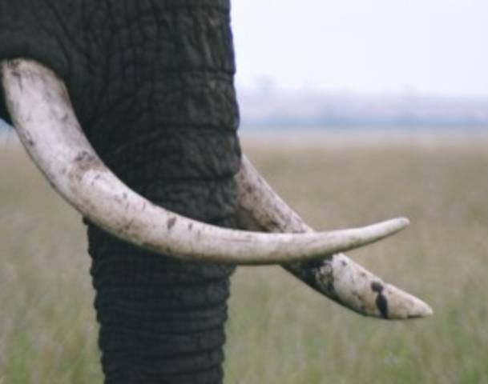
A trunk

Slide 8

A horn

Slide 9
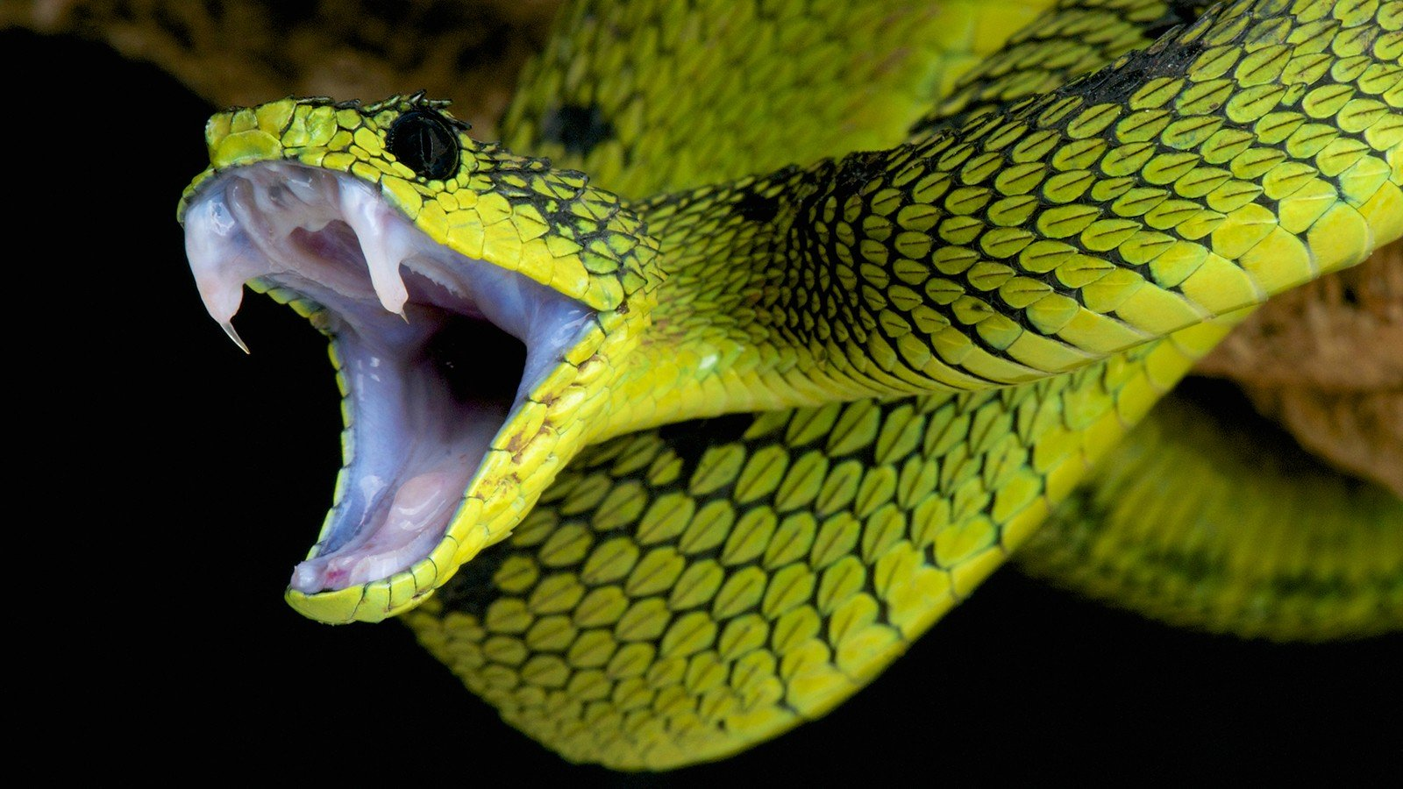
!dangerous!

Slide 10

To hunt

Slide 11
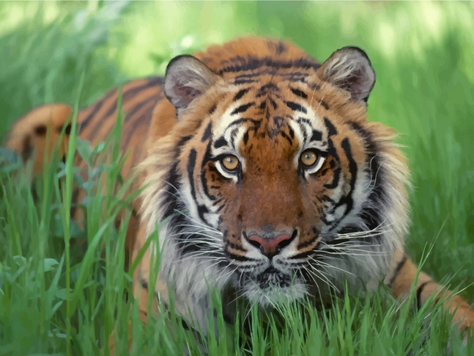
To hide in tall grass

Slide 12
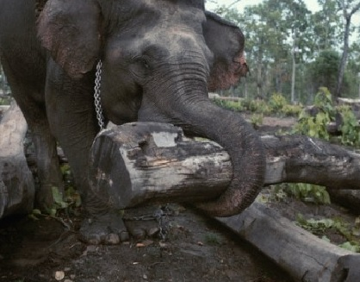
To carry heavy things

Slide 13
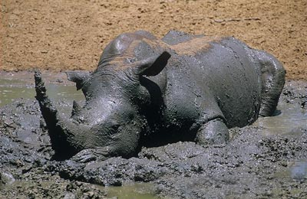
To sit in mud

Slide 14
1 group
Stripes, to hide, to hunt
the head of a family, heavy, a trunk
2 group
A horn, to sit in mud, dangerous
3 group

Slide 15
All the animals
The Bengal tiger is the national animal of India. It is red or orange with black, grey or brown stripes. It hides in tall grass and hunts big animals like deer. It is a really beautiful animal.
The Indian cobra is a black, brown, white or yellow snake. It is a very dangerous snake.
Indian elephants are very big and tall (2-3 metres), but they have small ears. Usually a big female is the head of a family of elephants. Indian people use elephants to carry heavy things with their trunks.
The Indian rhino is a funny animal! It only has one horn (African rhinos have two).It usually lives alone and likes to sit in water or mud. There are only about 2,500 Indian rhinos today.

Slide 16
All the adjectives
The Bengal tiger is the national animal of India. It is red or orange with black, grey or brown stripes. It hides in tall grass and hunts big animals like deer. It is a really beautiful animal.
The Indian cobra is a black, brown, white or yellow snake. It is a very dangerous snake.
Indian elephants are very big and tall (2-3 metres), but they have small ears. Usually a big female is the head of a family of elephants. Indian people use elephants to carry heavy things with their trunks.
The Indian rhino is a funny animal! It only has one horn (African rhinos have two).It usually lives alone and likes to sit in water or mud. There are only about 2,500 Indian rhinos today.

Slide 17
A CINQUAIN
MODEL
1.THE NAME OF THE ANIMAL
1. The Bengal tiger
2. TWO ADJECTIVES, CHARACTERIZING IT
2. Beautiful, dangerous
3.THREE VERBS,DESCRIBING IT
3. Walks, hunts, hides
4.A SHORT SENTENCE ABOUT THE ANIMAL
4. The tiger is a big cat
5. A NOUN, EXPRESSING YOUR FEELLINGS
5. An animal

Slide 18
Homework
Learn new words
Make up your own cinquain about animals

Slide 19
Reflection time
Now I know…
Now I can…

Slide 20
The song «Amazing creatures»

Slide 21
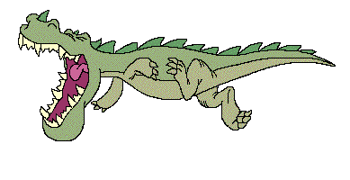



Thanks for your work!

Slide 22
Материалы Интернета:
http://nicewall.ru/wallpaper/19633/
http://www.liveinternet.ru/users/4202617/rubric/3092654/
http://stirileprotv.ro/stiri/bizar/ce-au-gasit-medicii-in-stomacul-unui-tigru-era-urias-n-am-mai-vazut-pana-acum-asa-ceva.html
http://www.wallpaperhere.com/American_Tiger_96338/download_preview
http://www.freevector.com/wallpaper/bengal-tiger-desktop-image/
http://www.liveinternet.ru/community/1793674/post173076394/
http://dilaila.ru/countries/9133/58/
http://www.liveinternet.ru/users/4202617/rubric/3092654/
http://new-obojka.ru/oboi/zhivotnie/1/640x480.html

