Slide 1
Elizabeth II
The Queen of the UK and NI
Made by Bodrov Nick
8 «Б» form

Slide 2
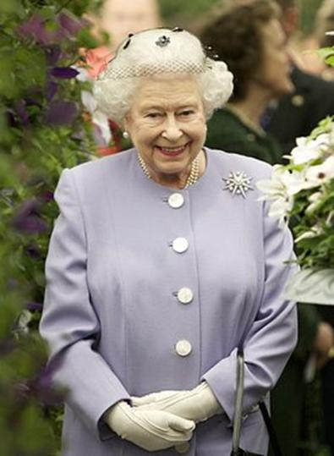
Elizabeth II
Elizabeth II Queen Elizabeth II since 1952 to the present. Elizabeth II is of the Windsor dynasty. Ascended the throne on 6 February 1952 at the age of 25 years after the death of his father king George VI.

Slide 3
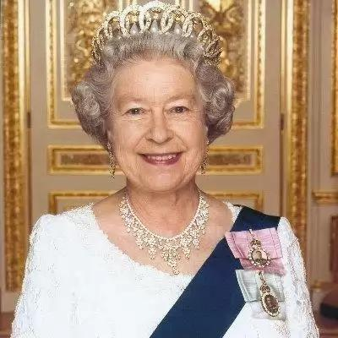
Elizabeth II
Is the head of the Anglican Church, the Supreme commander of the armed forces of great Britain, British Commonwealth and, in addition to the UK, the Queen of the 15 independent States.

Slide 4
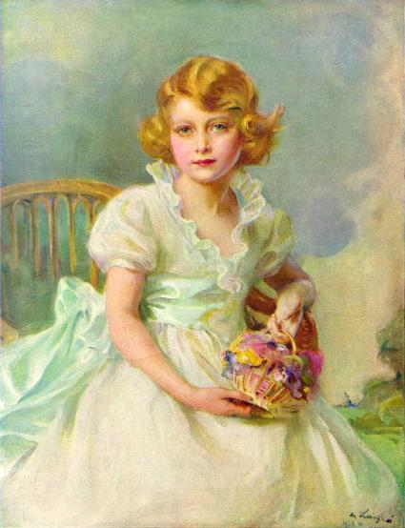
Princess Elizabeth Alexandra Mary was born in London's Mayfair in the residence of the Earl of Strathmore at Brewton-street, house number 17. She got her name in honor of his mother (Elizabeth), grandmother (Maria) and great-grandmother (Alexandra).

Slide 5
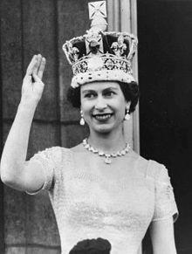
The ceremony of the coronation
The ceremony of the coronation of Queen Elizabeth II took place in Westminster Abbey on 2 June 1953. It was the first coronation of a British monarch to broadcast on television and considered, this event significantly contributed to the rising popularity of television.

Slide 6
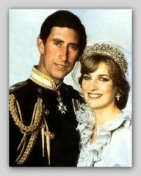
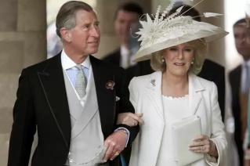
20 November 1947 Elizabeth married Lieutenant Philip His (genus. June 10, 1921), son of a Greek Prince Andrew, who received the title of Duke of Edinburgh.
In their family were born four children:
Prince Charles,
the Prince of Wales
on 14 November 1948
Lady Diana Spencer 29 July 1981
(divorce: August 28, 1996)
Prince William, Duke of Cambridge
Prince George of Cambridge
Prince Henry (Harry) Of Wales
Camille and April 9, 2005

Slide 7
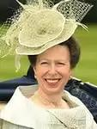
Princess Anne
"Princess of Royal blood" ("Princess Royal") on 15 August 1950 mark Phillips on 14 November 1973
(divorce: April 28, 1992) Peter Phillips Savannah Phillips
Isla Elizabeth Phillips
Zara Phillips MIA Grace Tindall
Timothy Lawrence 12 December 1992

Slide 8

Prince Andrew
the Duke of York on 19 February 1960 Sarah Ferguson on July 23, 1986
(divorce: may 30, 1996) Princess Beatrice of York
Princess Eugenia (Eugenia) York

Slide 9
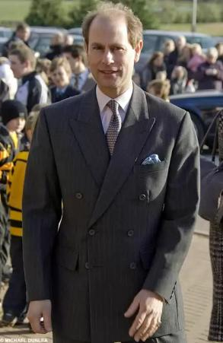
Prince Edward
Earl of Essex on March 10, 1964 Sophie Rhys-Jones on June 19, 1999 Lady Louise Windsor
James, Viscount Severn

Slide 10
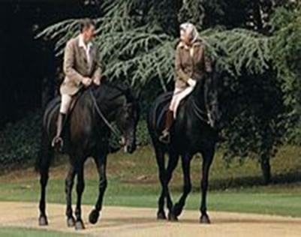
Hobbies & personal life
Among the interests of the Queen - breeding dogs, photography, horse riding, and travel. Since 2009 she started gardening.

Slide 11
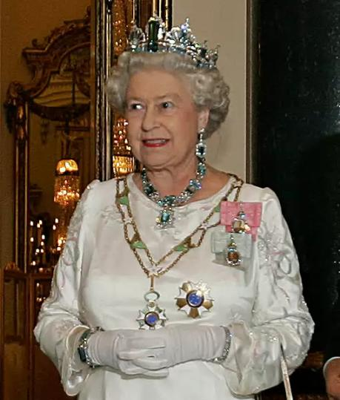
The magazine 'Forbes' 2010 estimated personal fortune of Elizabeth II in approximately us $ 450 million. On the monarchy, according to Buckingham Palace, spend about 50-70 million dollars each year.

Slide 12
THANK YOU FOR YOUR ATTENTION

