Slide 1
My activity
Presentation is made
by Bodrov Brothers

Slide 2
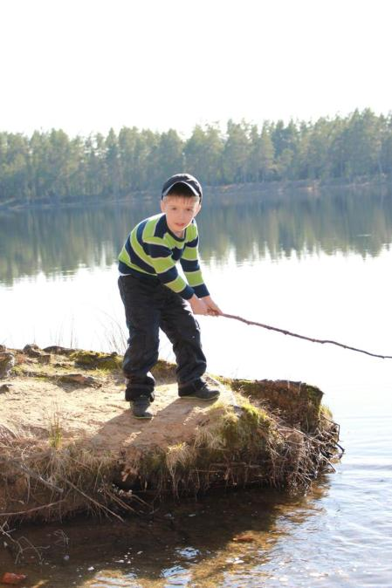
I like fishing

Slide 3
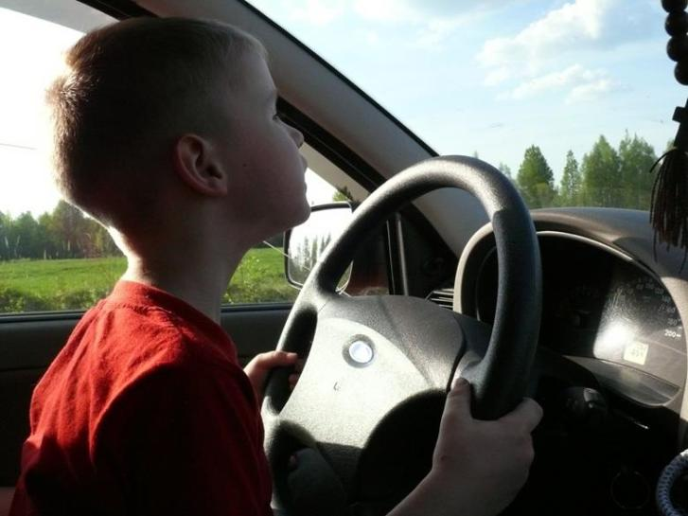
I like to drive a car

Slide 4
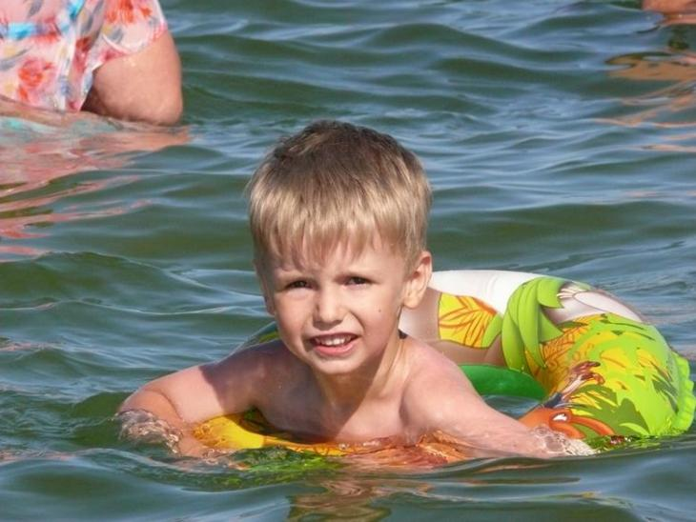
I like swimming in the sea

Slide 5
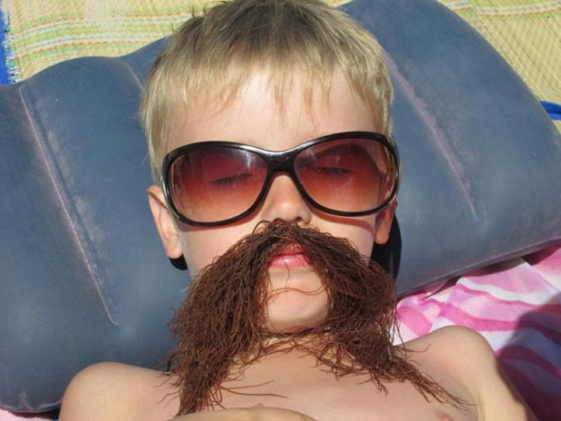
After swimming
I take a sunbath

Slide 6
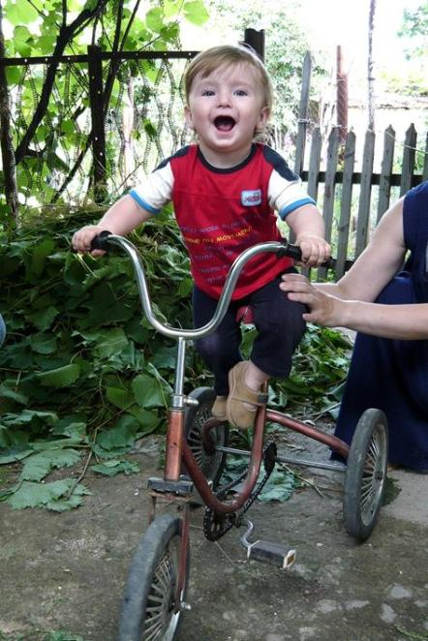
I like to ride a bike

Slide 7
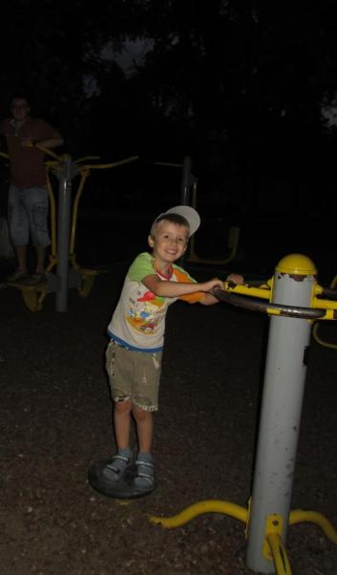
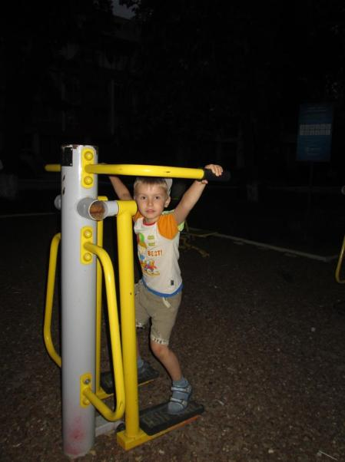
I like to do sports

Slide 8
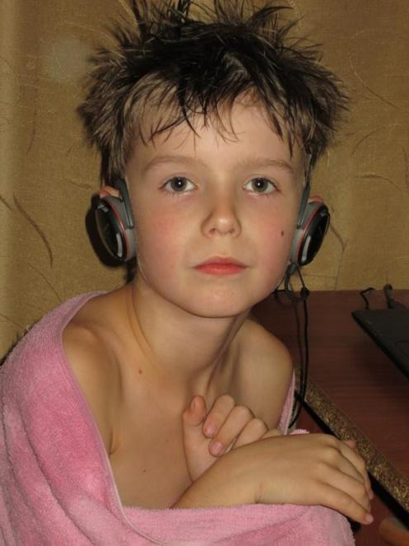
After doing sports
I take a shower

Slide 9
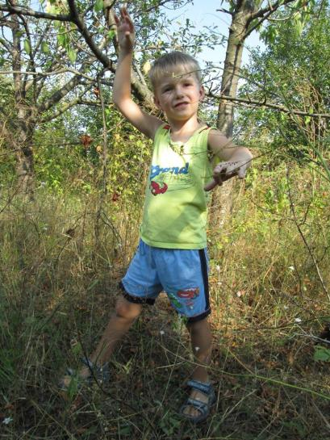
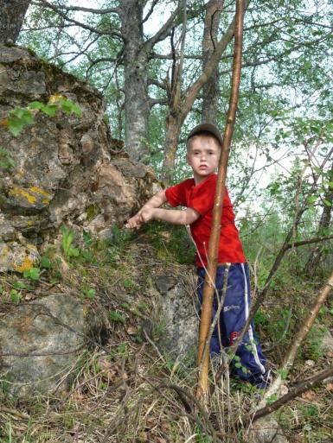
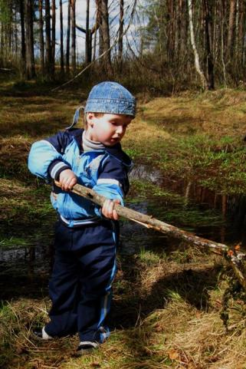
I like going on a picnic to the forest

Slide 10
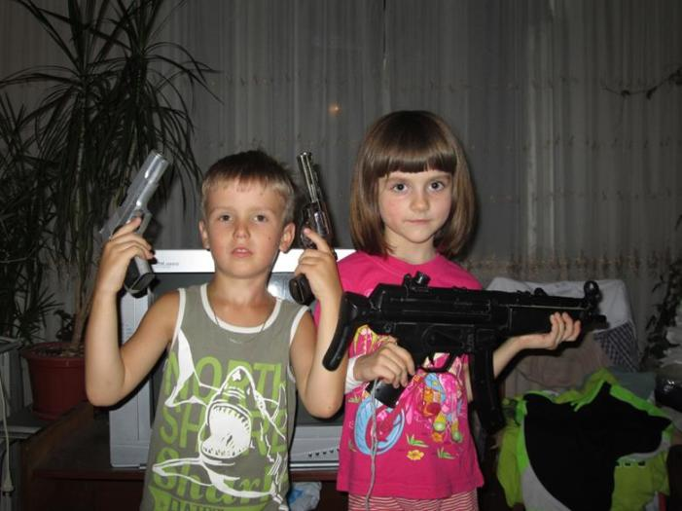
Like all kids
I love playing with toys

Slide 11
Thanks for your attention!

