Slide 1
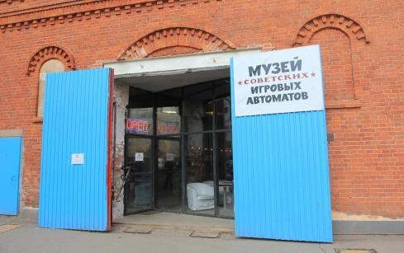
The Museum of Soviet arcade games
Created by
Bodrov Nick
9«B» form

Slide 2
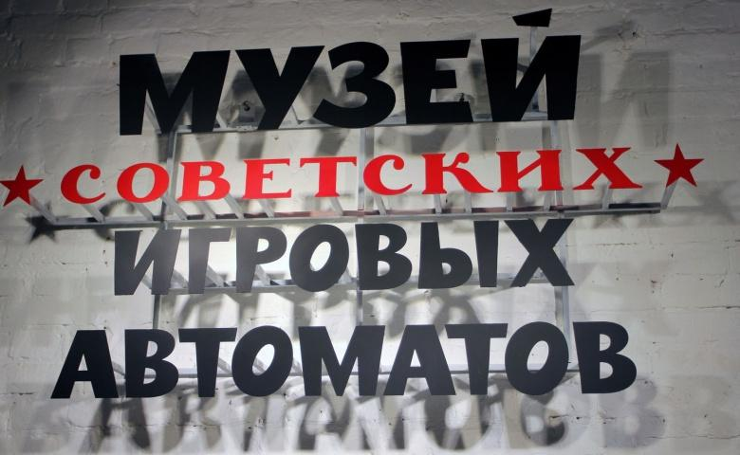
It`s one of the most amazing museums of the capital, receiving its visitors since 2007.

Slide 3
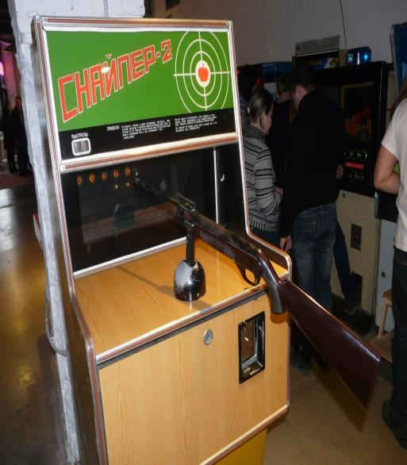
The only and unique collection of this Museum is a made in the USSR, beginning in the 1970s, slot machines. At the moment there are more than 60 slot machines. The most famous and successful, which allowed play to all comers, can be called, "Rally", "battleship", "Air battle", "Sniper", "Football", and many others.

Slide 4
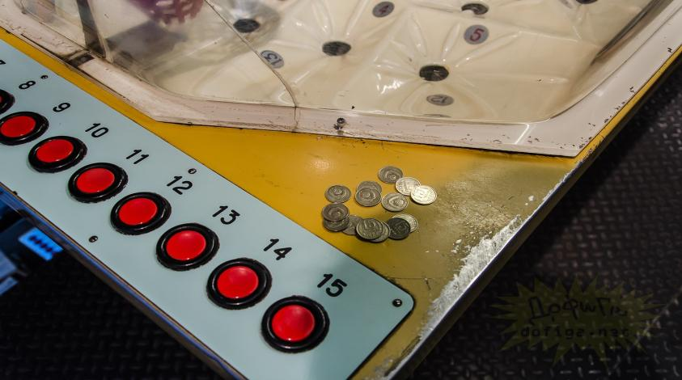
Inside it is similar to the most common playing room. However, starting to play the machines, instantly forget about the internal decor of the room and through space and time move to 20-30 years ago, when this game cost only 15 cents.

Slide 5
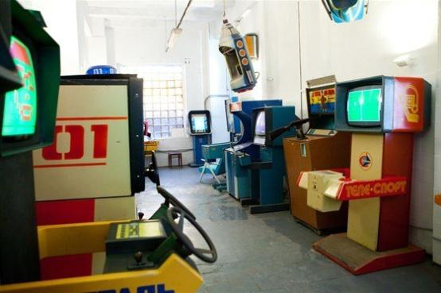
By purchasing a ticket to the Museum, you will be given 15 Soviet coins. If you need more, then you will be able to purchase more coins: over 300 Russian rubles you will get 15 coins of the USSR. Tickets cost 450 roubles.

Slide 6
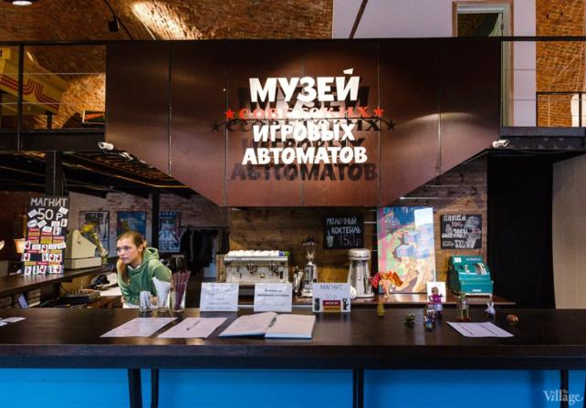
And the Museum provides additional services such as rental, slot machine, rooms for celebrations and corporate events. The Museum also has a café.

Slide 7
Thank you for your attention!

