Slide 1
How to do a chandelier
АВТОР ПРЕЗЕНТАЦИИ
ИВАНОВА АРИНА, УЧЕНИЦА 5Б КЛАССА

Slide 2
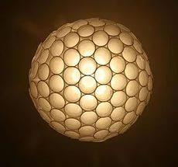
chandelier

Slide 3
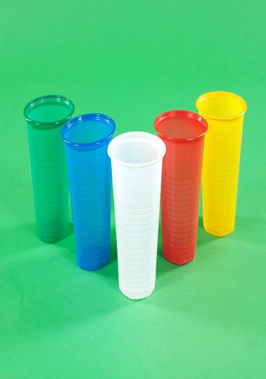
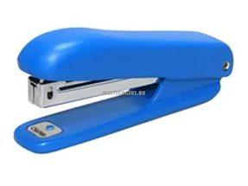
FOR WORK WE NEED PLASTIC AND A STAPLER

Slide 4
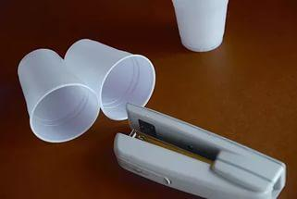
PUT THE CIRCLE ON THE TABLE AND SKRIPSI STAPLER

Slide 5
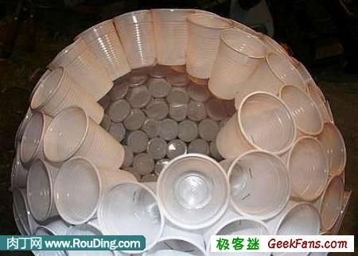
CONTINUE YET NOT STAY LITTLE HOLE

Slide 6
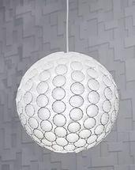
ATTACHED TO PATELCO AND THE CHANDELIER IS READY

Slide 7
GOOD LUCK !

