Slide 1
How to do a basket
Made by Makarov Vladislav
and Shamansky Nickita

Slide 2
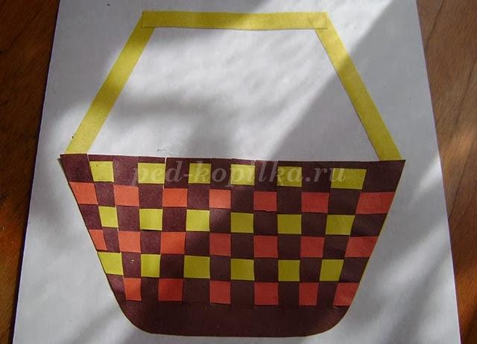
Beautiful basket

Slide 3
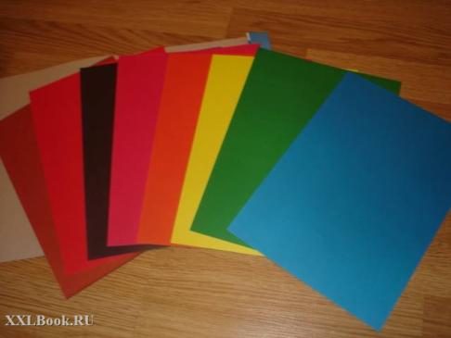
Take colored paper.

Slide 4
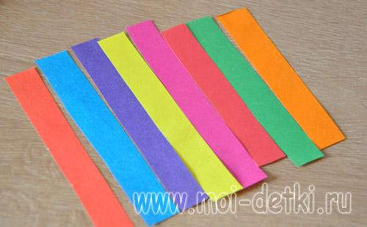
Cut into strips 5 cm

Slide 5
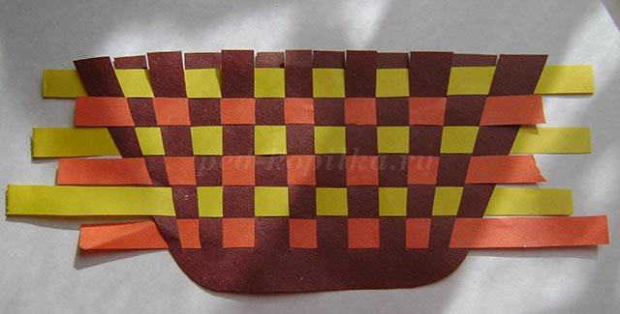
The strips are intertwined in the form of the basket

Slide 6
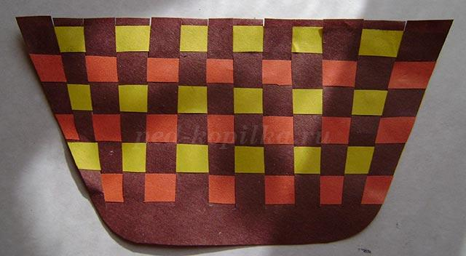
Cropped shape and glue on the paper form of the basket

Slide 7

Make a handle

Slide 8
Thank you for your attension!

