Slide 1
Suffixes:
-ist, -ian, -ect, -er
Урок грамматики
Wordbuilding
6 класс
Бодрова И.В.,
учитель английского языка
МОУ «Жарковская СОШ №1»

Slide 2


-ist
Art
Science

Slide 3
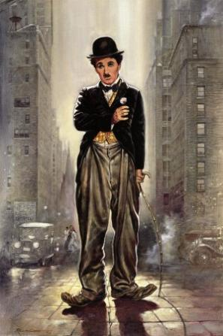
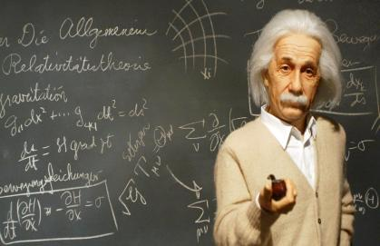
-ist
Artist
Scientist

Slide 4
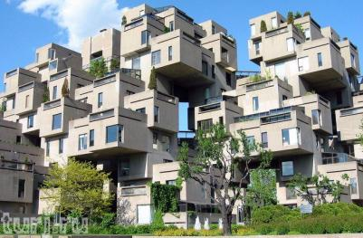
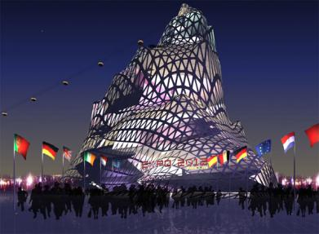
-ect
Architecture

Slide 5
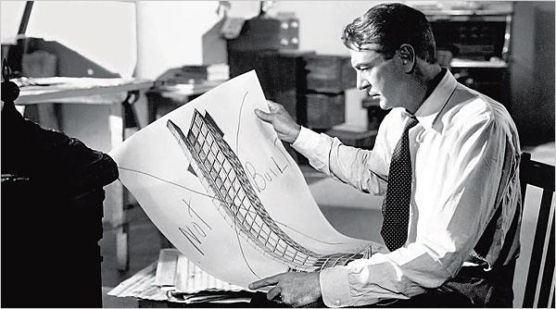
-ect
Architect

Slide 6

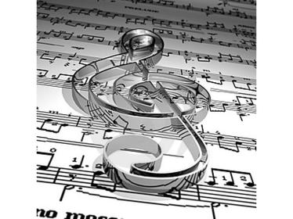
-ian
Politics
Music

Slide 7
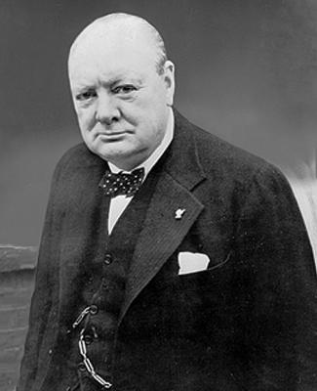
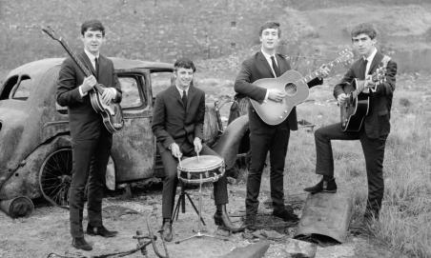
-ian
Politician
Musician

Slide 8
-er
Bank
To teach
To write
To run
To swim
To sing
To dance

Slide 9
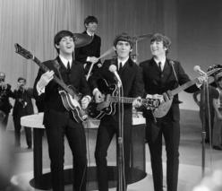
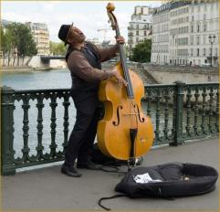
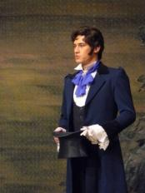
-er
banker
teacher
writer
runner
swimmer
singer
dancer

Slide 10
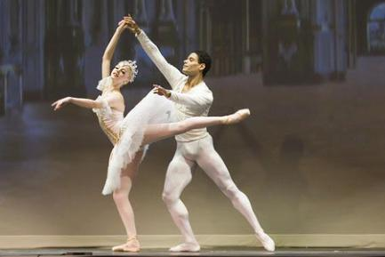
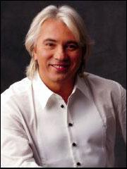
+ noun
ballet – ballet dancer
opera – opera singer

Slide 11
Profession
Swimmer
Ballet dancer
Opera singer
Politician
Musician
Poet
Architect
Artist
Scientist
Banker
Тeacher
Writer
Runner

Slide 12
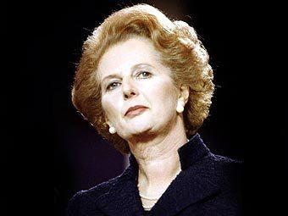
Do you know these people?

Slide 13
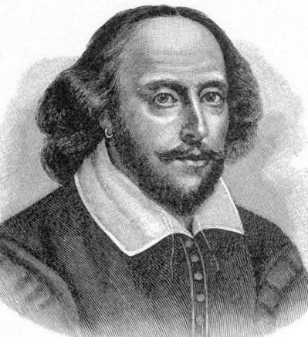
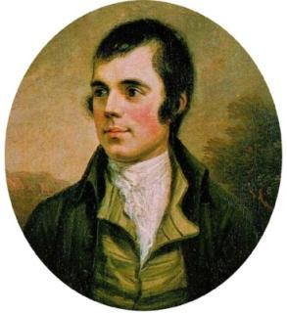
Do you know these people?

Slide 14
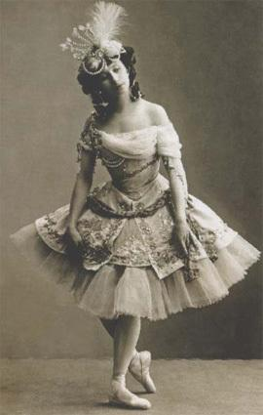
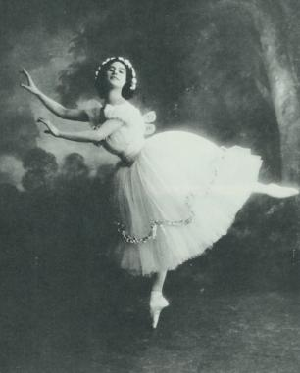
Do you know this dancer?

Slide 15
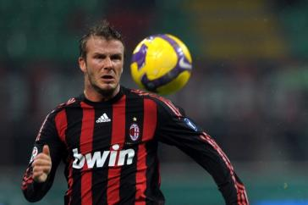
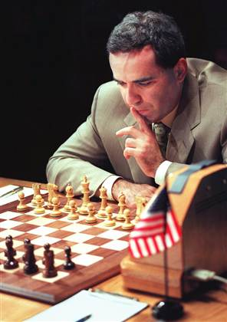
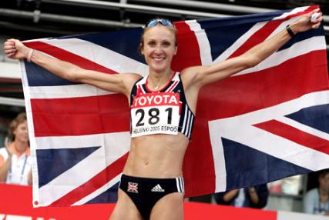
Do you know these people?

Slide 16
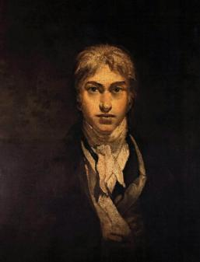
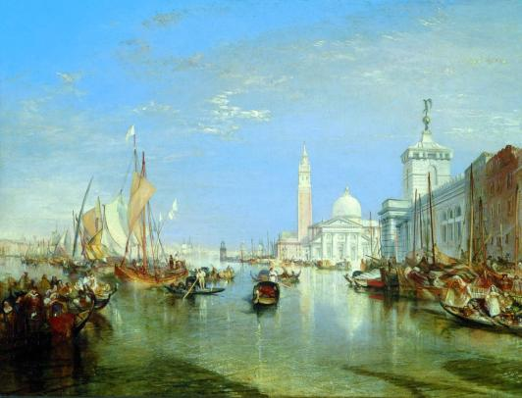
Do you know this artist?

Slide 17
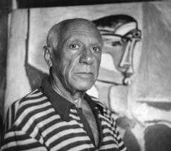
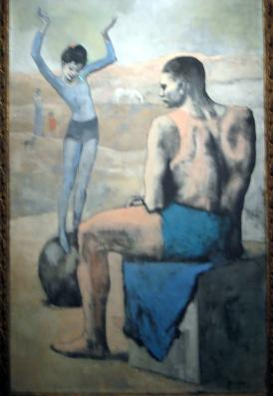
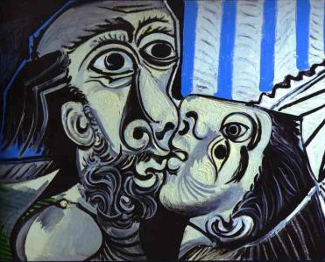
Do you know this artist?

Slide 18
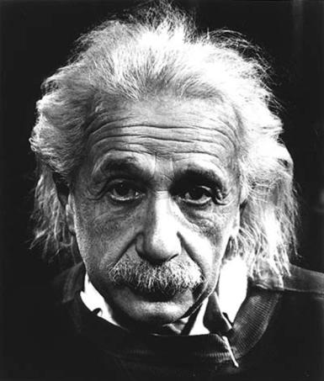
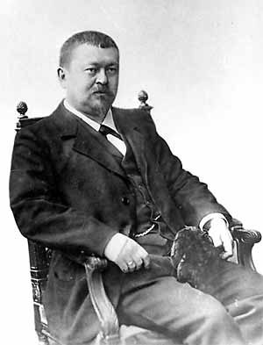
Do you know these people?

Slide 19
Thank you for your attention!

