Slide 1
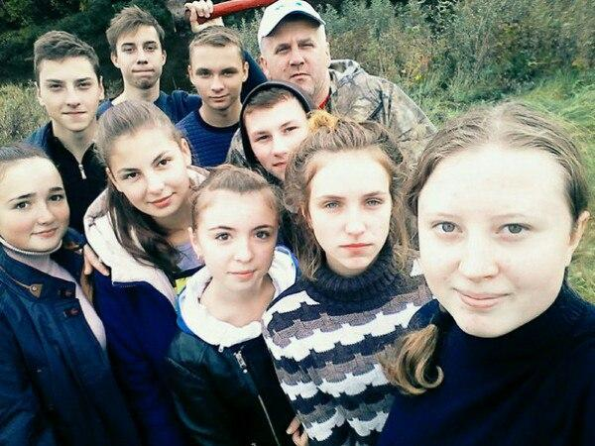
Hobbies of my classmates.
The presentation was prepared by students 10 "B" class
Suvorova Anastasia, Spiridonova Mariya, Nefedova Angelika, Baykova Anastasia.

Slide 2
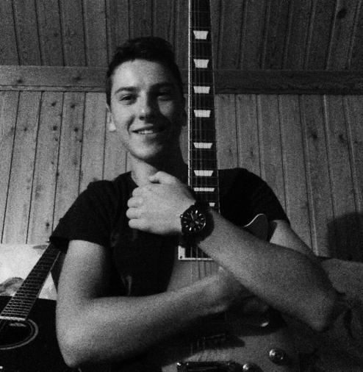
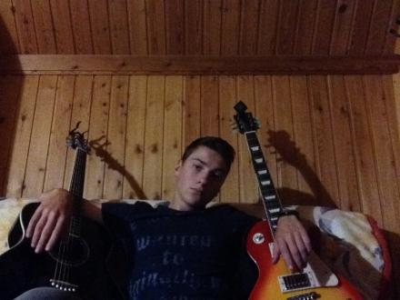
Reporter: Sergey, tell me about your Hobbies.
Sergey: I like to listen to music. I can do it all day. I like to play different songs on the guitar and want to create a band.

Slide 3
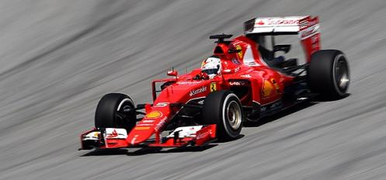
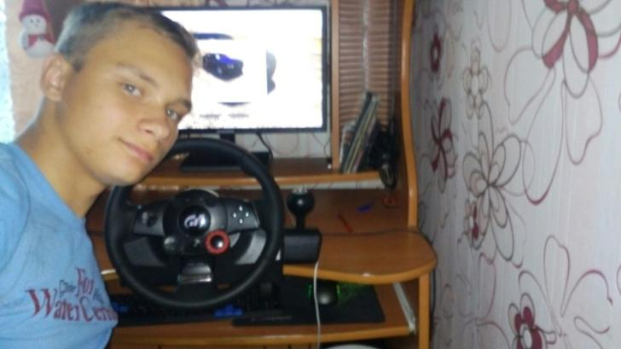
Reporter: Igor, what kind of sport you prefer to watch?
Igor: I watch Formula 1 because it's cool, fun and exciting sport. It has speed, it really attracts me, I'm ready to watch it all day. I'm a fan of Michael Schumacher. Very sorry he no longer plays.

Slide 4

Reporter: Anna, how do you spend your weekend?
Anna: My weekends I spend with friends or reading books.
Reporter: What literature do you prefer?
Anna: I like fanfiction, novels, detectives.
Reporter: What's the last book you read?
Anna: "Fathers and sons“ .
Reporter: How interesting!

Slide 5
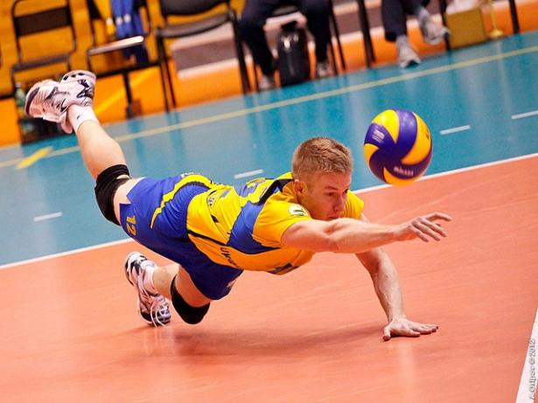
Reporter: Max, do you play sports?
Max: Yes, volleyball.
Reporter: Why?
Max: To keep fit.
Reporter: How often do you do this?
Max: 3 times a week. Monday, Wednesday, Friday.
Reporter: Why did you choose this sport?
Max: It develops my physical abilities.
Reporter: That’s great!

Slide 6
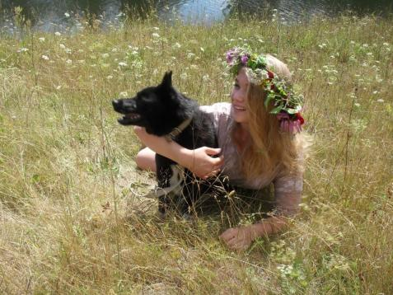

Reporter: Lisa and Olga, how do you spend the evening on weekdays?
Lisa: I'm watching TV.
Reporter: Why?
Lisa: To be the course of events.
Olga: I also watch TV and walk the dog. We compete with him, who will run faster.
Reporter: Thank you. Goodbye.

Slide 7
Thank you for your attention!

