Slide 1
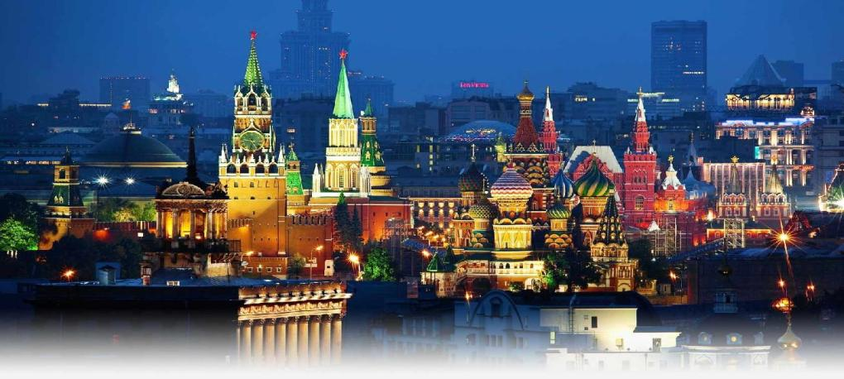
Made by Egorenkov Serghey
Moscow Attractions

Slide 2
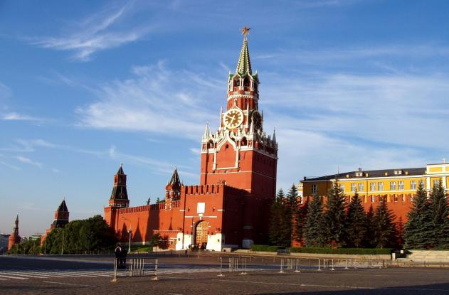
The Kremlin.
The Kremlin in Russia is one of the most ancient parts of Moscow city. It is considered as a symbol of whole Russia. The Kremlin is a center of Russian State, cultural sight, residence of Russian Federation president. In 1990 the Kremlin was included to the list of UNESCO.

Slide 3
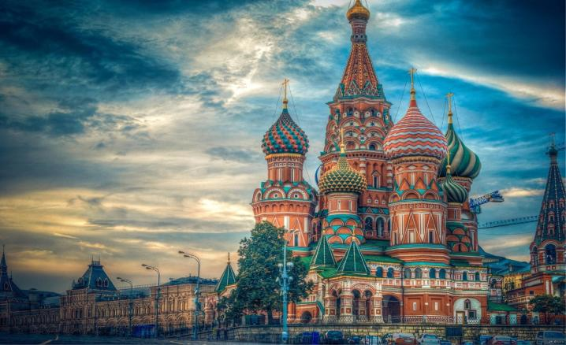
St Basil's Church. The most famous Russian church is located on the opposite side of the Red Square. St. Basil's Cathedral was built in the sixteenth century during the reign of Ivan the Terrible. There is a legend about the church - after Ivan the Terrible saw the completed masterpiece of architecture, it is an order to deprive of architects so that they could not build anywhere else such a grand building.

Slide 4
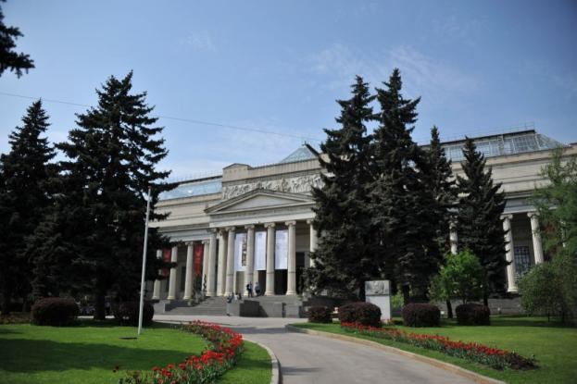
Pushkin Museum of Fine Art. It is the largest museum of European art in Moscow. The founder of the Pushkin Museum of Fine Art is Professor Ivan Tsvetayev. The Museum was built in 1912. The Museum also has one of the worlds largest collection.

Slide 5
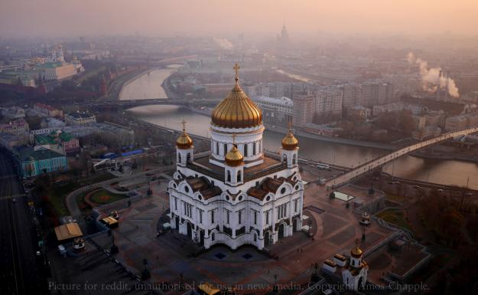
Cathedral of Christ the Savior in Moscow. Cathedral of the Russian Orthodox Church (street Volkhonka 15-17). Existing structures - Implemented in the 1990s outside the reconstruction of the temple of the same name, created in the XIX century
The original temple was built in memory of the Napoleonic invasion by the architect KA Ton. Construction lasted for almost 44 of the year: the church was founded September 23, 1839, consecrated - May 26, 1883. The temple was destroyed at the height of Stalin's reconstruction of 5 December 1931. It rebuilt in 1994-1997.

