Slide 1
USA
By Nastya Baykova

Slide 2

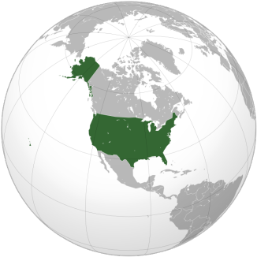
Official name and position
United States of America (USA), often used in the United States, or simply America (eng. United States of America, USA, U.S., America) is a country in North America. Total area of 9.5 million km2 (4th largest in the world). The population is 325 million people ( 3rd largest in the world).
The capital of the USA is Washington.
The United States border to the North by Canada, on the South by Mexico, also have a Maritime border with Russia. Washed by the Pacific ocean to the West, Atlantic ocean in the East, and the Arctic ocean in the North.

Slide 3
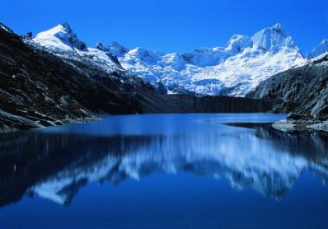
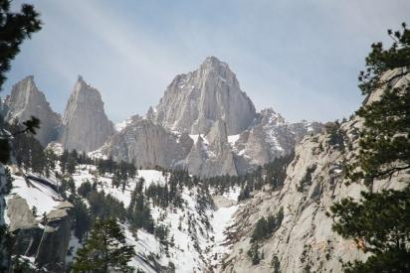
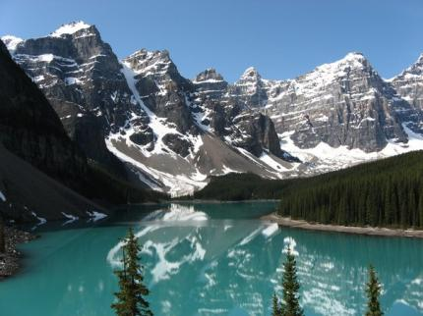
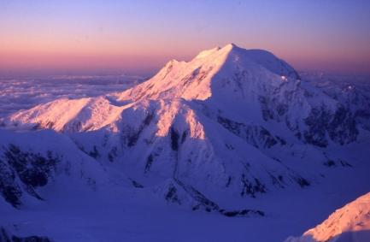
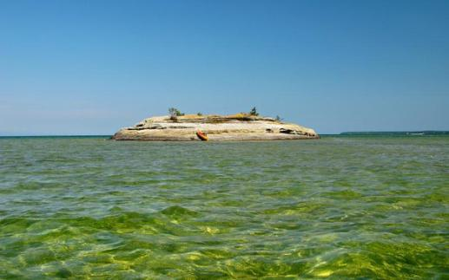
Mountains,rivers and lakes
If we look at the map of the USA, we can see lowlands and mountains. The highest mountains are the Rocky Mountains, the Cordillera, and the Sierra Nevada. The highest peak is Mount McKinley, which is located in Alaska.
the Cordillera
the Sierra Nevada
the Rocky Mountains
Mount McKinley

Slide 4
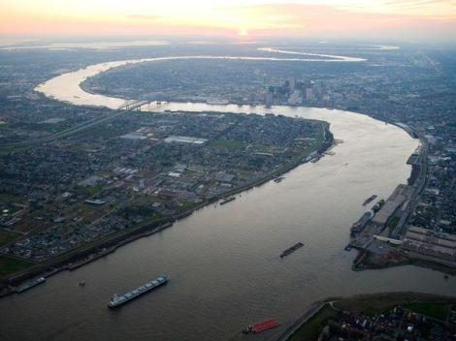
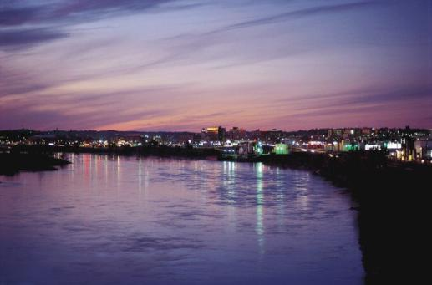
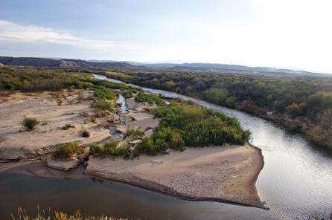
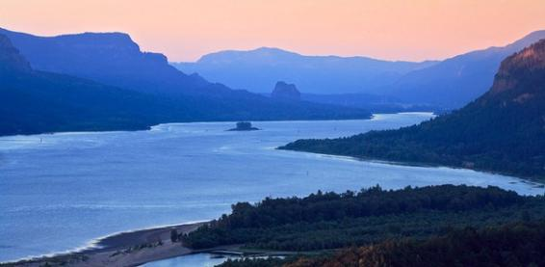
America's largest rivers are the Mississippi, the Missouri, the Rio Grande, and the Columbia.
the Mississippi
the Missouri
the Rio Grande
the Columbia

Slide 5
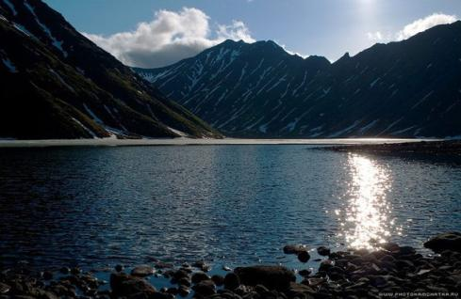
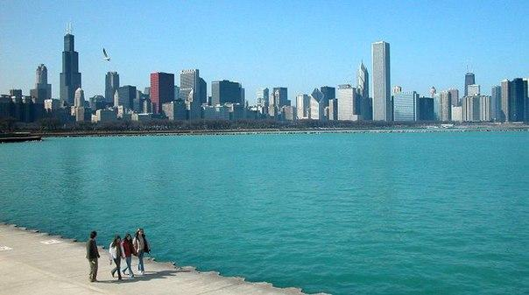
Great lakes on the border with Canada, such as Upper, Huron, and Michigan are the largest and the deepest in the USA.
Upper
Michigan
Huron

Slide 6
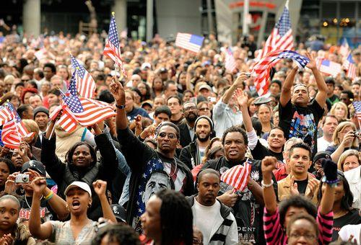
The official languages of the USA
Languages of the United States of America — many languages, with different degrees and different distribution status in the USA. Dominant in the country because of its British colonial past is the English language brought by colonizers and early immigrants from British Isles. However, the country has no official language at Federal level though.
However, a number of languages (Spanish, French and Hawaiian) are recognized as official in some States and territories.

Slide 7
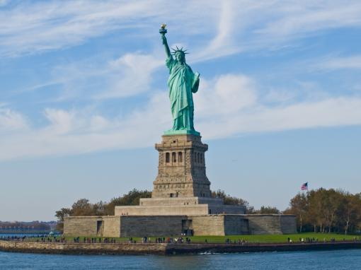
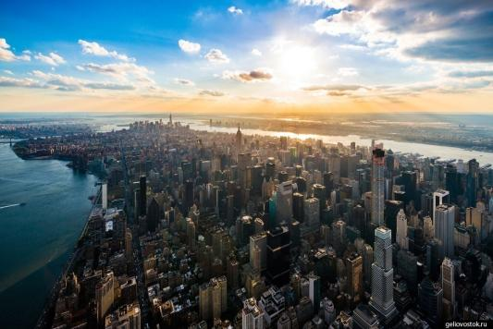
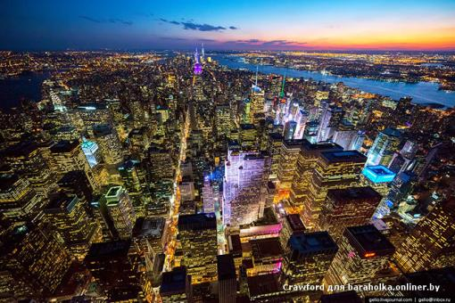
Major cities USA
Some of the largest U.S. cities are New York, Los Angeles, Chicago,Washington and so on.
1.New York
Population: 8 336 697 people. the Largest city in the U.S. and one of the largest agglomerations in the world. The population with the suburbs is about 20 million. Located on the Atlantic ocean in the southeastern part of the state of New York. New York was founded in the early 17th century by Dutch colonists.
New York — the major economic center of the United States and around the world. New York, along with London and Tokyo, as one of three main hubs of the global economy. Financial institutions located in the city, at the end of 2008 controlled 40% of global Finance.
The city consists of five boroughs: the Bronx, Brooklyn, Queens, Manhattan and Staten Island. The city area is 1214.9 km². Skyscrapers are the basis of modern architecture in New York.

Slide 8
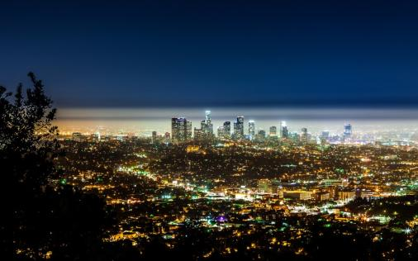
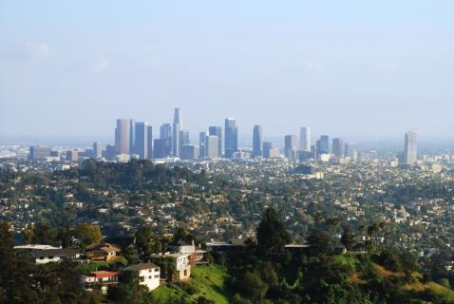
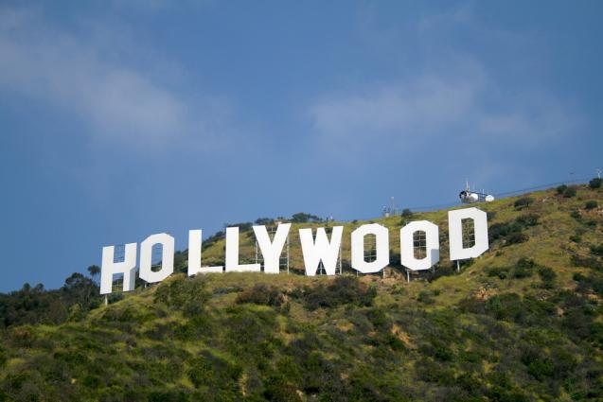
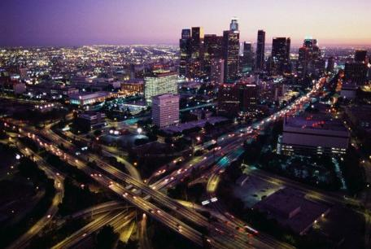
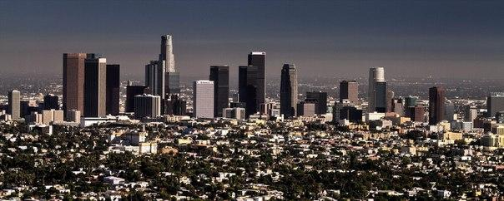
2. Los Angeles, CA
Population: 857 799 3 people is Located in southern California located on the Pacific ocean. The largest by population in the state and second in the country. The population of greater Los Angeles, CA above 17 million people. Los Angeles is one of the world's largest cultural, scientific, economic, educational centers. The city is also one of the largest world centers of entertainment industry in film, music, television, and computer games.

Slide 9
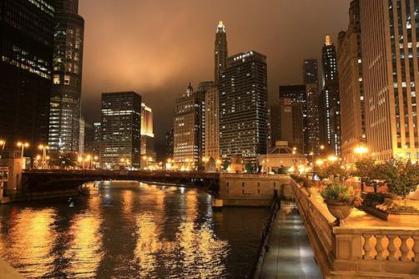
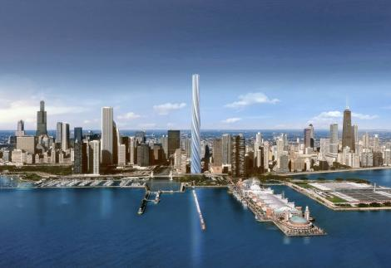
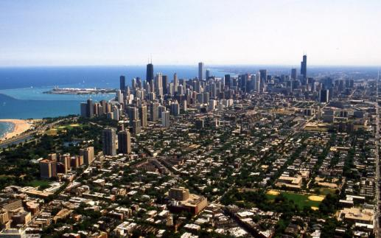
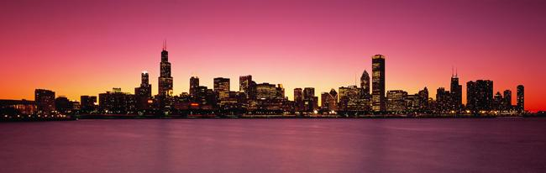
3. Chicago
Population: 2 714 856 people. the Second most important financial center of the country and the largest transportation hub in North America. Located on the southwest coast of lake Michigan, in Illinois. The Chicago agglomeration (different suburbs) called "the Big Chicago" or "Chicago Country" it is home to about 10 million people. The Chicago agglomeration occupies the 26th place in the world for number of inhabitants. Chicago is considered the economic, industrial, transport and cultural capital of the Midwest.

Slide 10
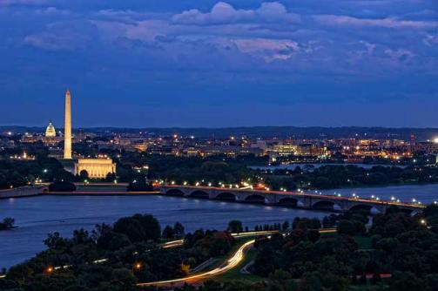
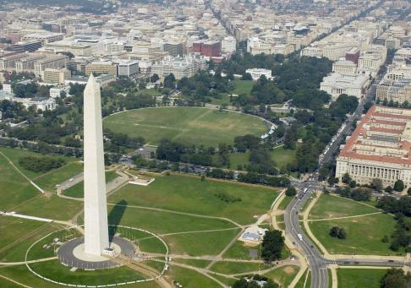
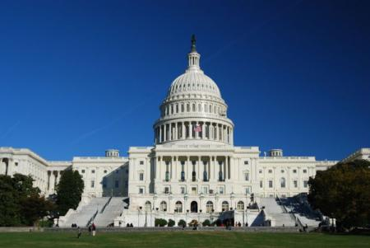
4. Washington The beautiful city of Washington D.C. is the capital of the United States and the centre of its government. The capital was named after the first president George Washington and was founded in 1790. It is situated on the Potomac River in the District of Columbia. Washington is not the largest city in the USA. It has about 900 000 inhabitants.
Washington D.C. has nothing characteristically American in it, as its conception is purely French. It has long wide avenues, gardens, beautiful parks and no skyscrapers at all.

Slide 11
Thank you
for your attention!

