Slide 1
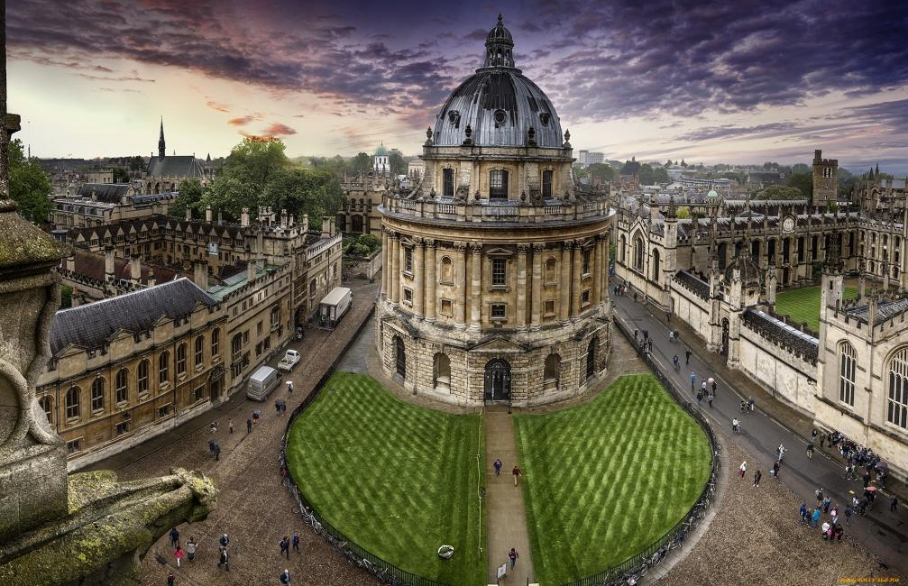
Country profile for Britain
Presentation by Suvorova Anastasia, Nephedova Angelica, Ermolaeva Ann.

Slide 2
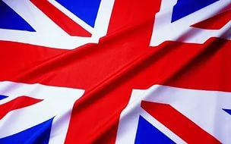
Полная официальная форма — Соединённое Короле́вство Великобрита́нии и Се́верной Ирла́ндии (англ. The United Kingdom of Great Britain and Northern Ireland, по-английски обычно сокращается до «United Kingdom» «Соединённое Королевство») — островное государство на северо-западе Европы.

Slide 3
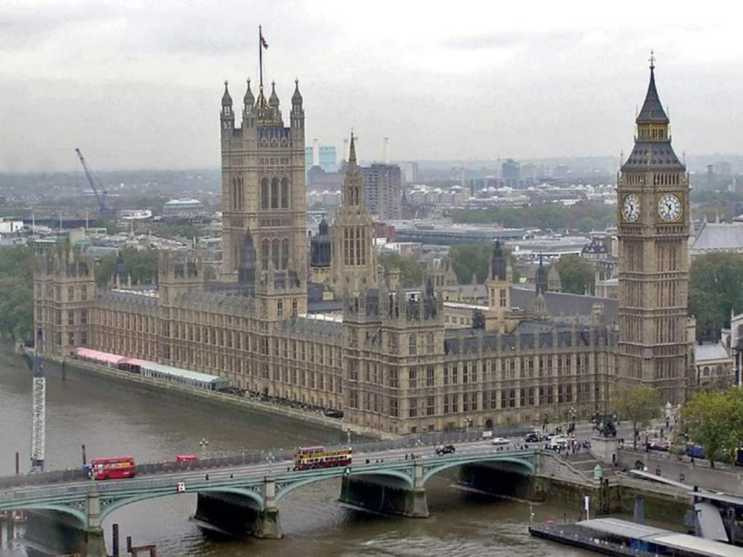

Slide 4
Britain is one of the largest States in Europe.
The state in Northwest Europe, in the British Isles. Is the island of great Britain (England, Scotland and Wales) and part of the island of Ireland, as well as an independent administrative unit - the Isle of man and channel Islands.
The UK is washed by the Atlantic ocean on the North and West, the North sea on the East and the Irish sea on the West, to the South is separated from the mainland by the Straits of La Manche and Pas-De-Calais. On the West and North of the country is dominated by a mountainous, heavily dissected terrain in the South-East and Central - plains and Barrens. The highest point is, Ben Nevis in Scotland (1343 m). The total area of the country 244.1 thousand sq. km.
Capital
London.

Slide 5
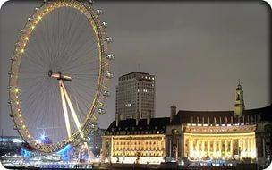
The ethnic composition of the population
The largest group of the UK population is English people who inhabit England, most of Wales and form compact settlements in some areas in the South of Scotland. The Scots inhabit mainly Scotland — the North-Western region of the island of great Britain and adjacent to the coast of Shetland, Orkney and Hebrides Islands. In the mountains of the North-Western part of the island is home to a peculiar ethnic group that preserves distinctive traditions and culture of the gaels (highlanders). The Welsh — inhabit mainly Wales. In Northern Ireland live 500 thousand indigenous people — the Irish (Catholics) — and 1 million Anglo-Irish and Scotland-Irish.
Nationality according to census 2001
"White" skin color — 92.1% of (54,153,898), including the British ("white" skin color) — 85,7 % (50,336,497).

Slide 6
Nationality according to census 2001
"White" skin color — 92.1% of (54,153,898), including the British ("white" skin color) — 85,7 % (50,336,497). 45 % of non-white citizens live in London (78 % of black Africans, 61 % of black residents of the Caribbean, 54% of Bangladeshis). Pakistanis: 19% London, 21 % — Western highlands, 20 % in Yorkshire and 16% in the North-West. Nebelenogo resettlement of the population: England 9 %, Wales, Scotland — 2 %, North. Ireland — less than 1 %, Uplands — 13 %, South-East and North-West 8 %, Yorkshire and the Humber — 7 %.

Slide 7
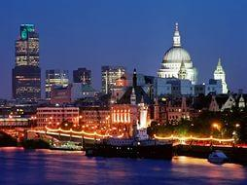
The official language is English, while actively there are a Scottish language and two Celtic language: Welsh and Gaelic.
Major cities in the UK
City England:
Birmingham
Cambridge
Leeds
Liverpool
London
Manchester
Nottingham
Newcastle-upon-Tyne
Oxford
Sheffield
The City Of Scotland:
Aberdeen
Edinburgh
Glasgow
Town Of Wales:
Cardiff
City Northern Ireland:
Belfast

Slide 8
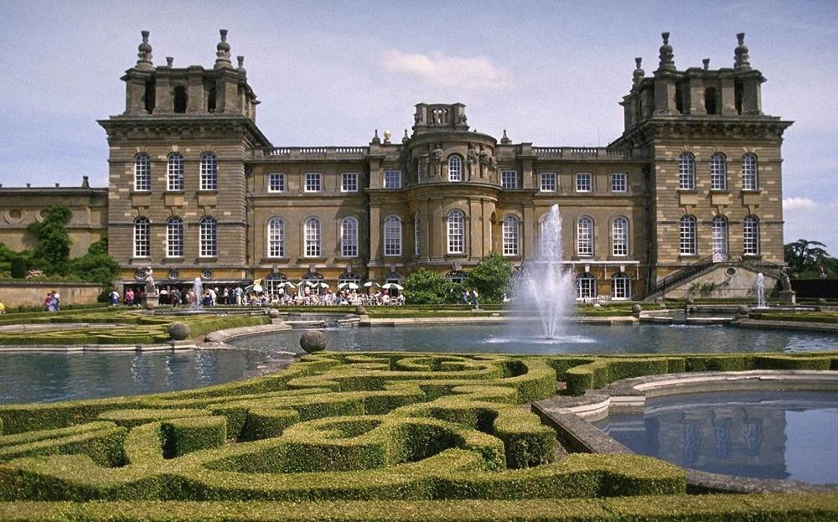
Thank you for your attention!

