Slide 1
My everyday food
Made by pupil of from 10
Belitskaya Natasha

Slide 2
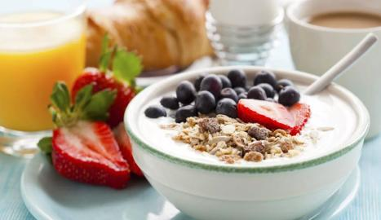
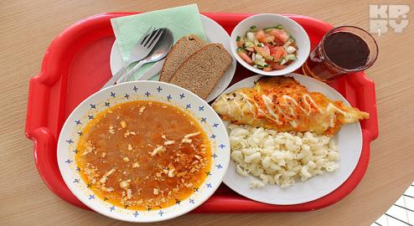
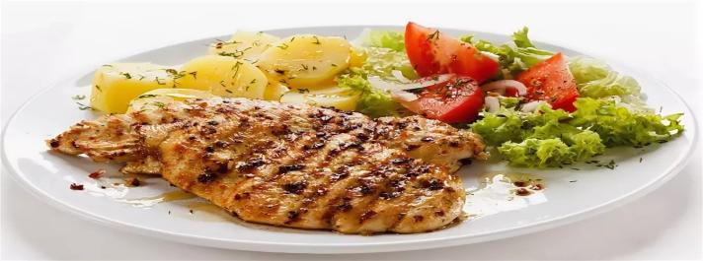
I usually have 3 meals a day. They are breakfast, lunch and dinner.
.

Slide 3
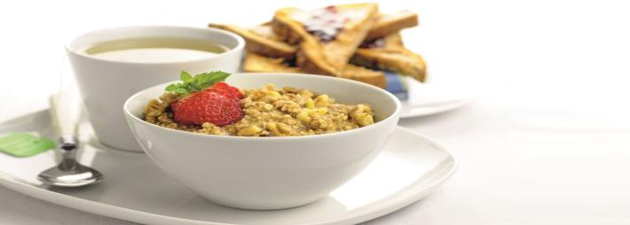
Breakfast
Breakfast is the most important meal, because it gives me energy for the day. I usually have breakfast at 7 o’clock before going to school. I usually have porridge with fruits.For breakfast, I always drink green tea with no sugar in it.

Slide 4
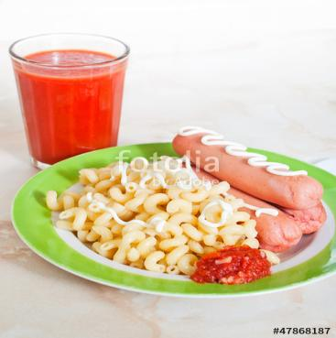
Lunch
Lunch I have in 2 or 3 hours. I eat lunch at school. I usually eat pasta with sausage or cutlet and drink tea.

Slide 5
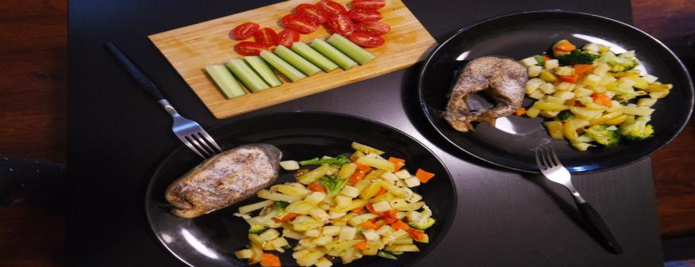
Dinner
The last meal of my day is dinner, which is at 6 or 7o’clock. My mother usually cooks fried fish or chicken and potatoes and salad. After dinner, I drink tea with biscuits.

Slide 6
Thank you for listening!

