Slide 1
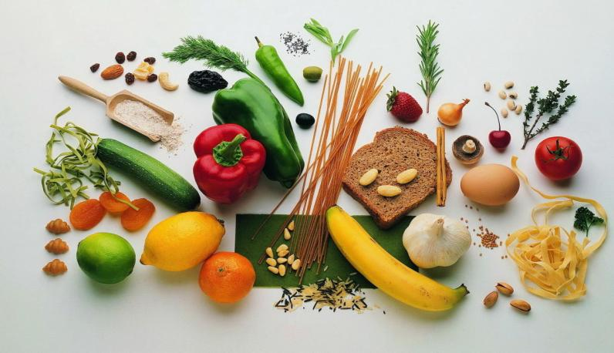
Food in my life.
Made by Polina Efimova

Slide 2
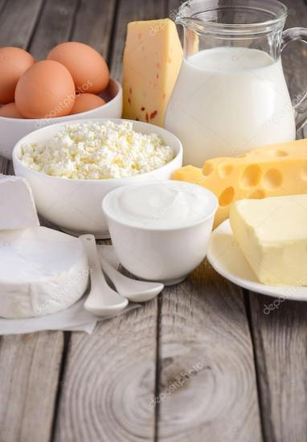
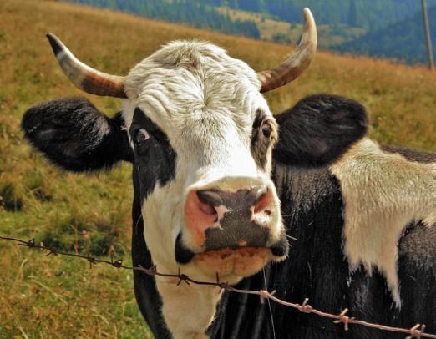
During childhood I often drank my grandmother fresh milk.
Her cows gave always a lot of cottage cheese and cheese.

Slide 3
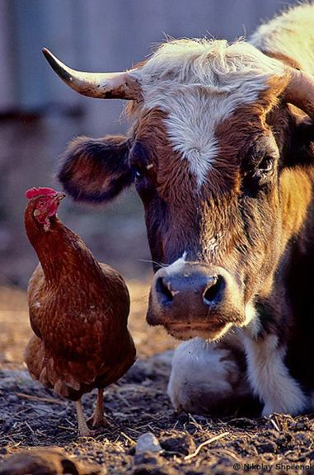
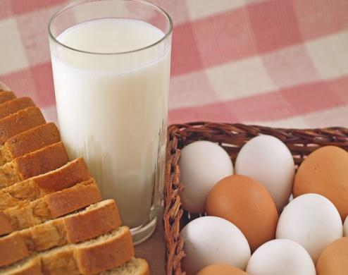
My brother eats usually a lot of milk products. My grandmother always gives us eggs of chickens.

Slide 4
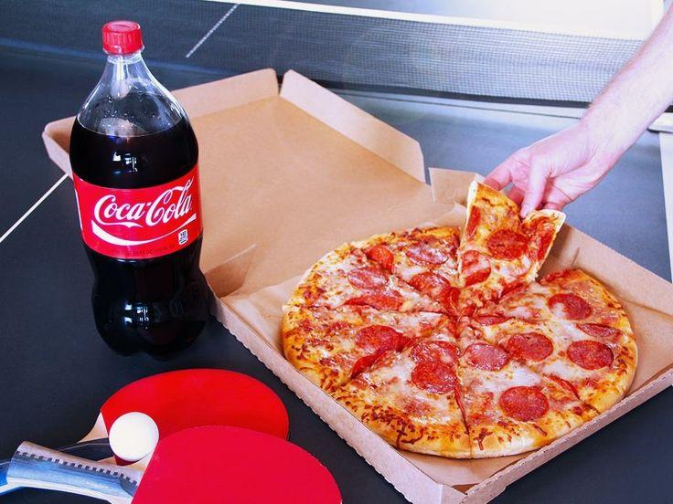
I am not eating now healthy and homemade food.
I was drinking soda from 5till6p.m yersteday.We have already finished cutting fruits.

Slide 5
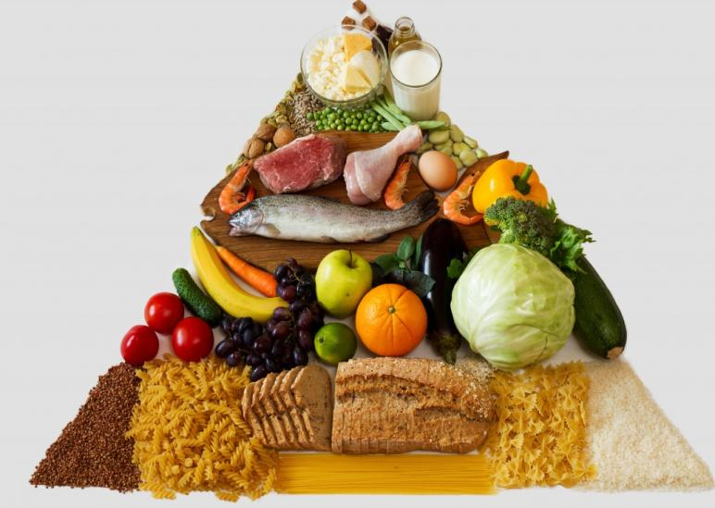
Thank you!

