Slide 1

Project
"An Ideal Welfare State"
project is made by
Prusova Maria,
Lopatina Ekaterina
Teacher:
Lyutova I.V.

Slide 2

Aim: to think of all the necessary aspects of our programme
"An Ideal Welfare State“.
Tasks:
1. to make basic principles.
2. to determine major spheres the welfare state operates in social security, insurance, health care.
3. to look sources of income, taxation.
4. to determine categories of citizens entitled to various benefits.
5. to determine different types of benefits (major and supplementary).
6. to determine conditions upon which these benefits can be received.
7. to determine organs of responsibility: government and local authorities.

Slide 3



Basic principles the welfare state operated in social security, insurance, health care.

Slide 4


Sources of income are taxation and charities.

Slide 5
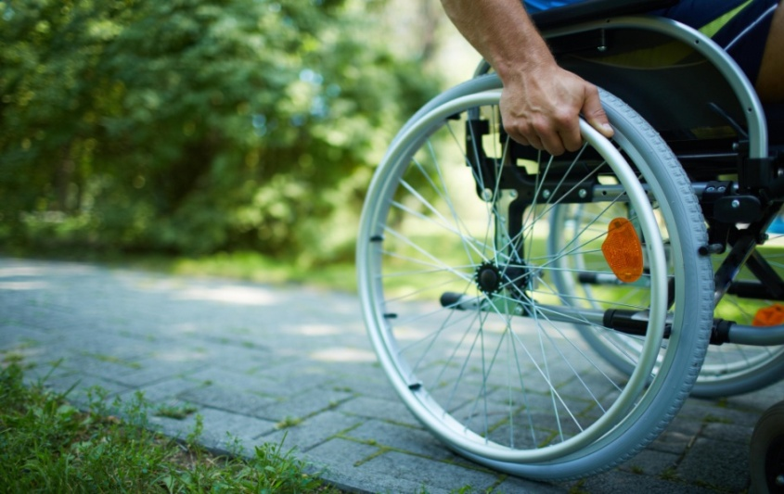
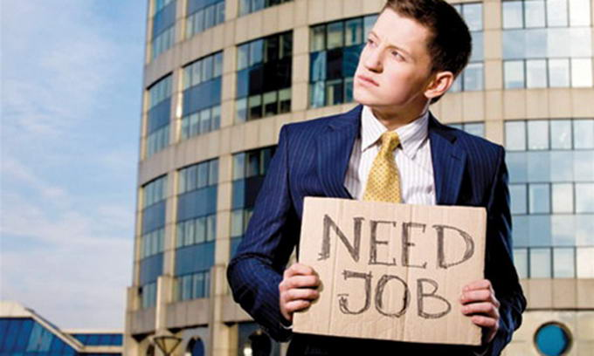
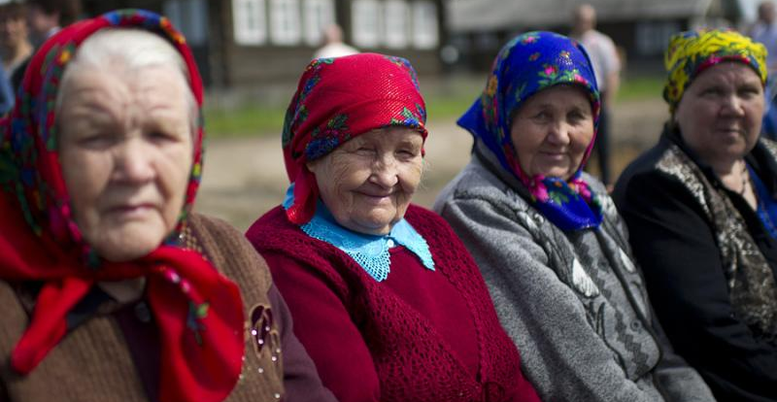
Categories of citizens entitled to various benefits:
1. People who the unemployed entitled to unemployment benefit.
2. People who the disabled can receive invalidity pension.
3. People who the retired entitled to a pension.
4. The widowed can claim widows pension

Slide 6

Government responds conditions upon which these benefits.

Slide 7

Thank you for yourattention!

