Slide 1

Национальная Авиация Академии
Азербайджан, Баку
Факультет: Транспортные технологии
Категория Студенты: Бехбудлы Шамиль
Работа представлена на английском языке

Slide 2
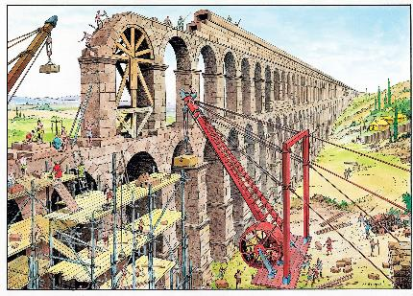
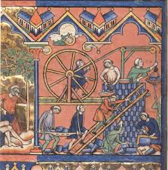
Many construction equipment is used in the construction of buildings and structures: graders, excavators, dampers, concrete mixers, cranes, etc., designed to perform certain operations on the construction site. Give examples and describe the evolution of building technologies from ancient times to the present day. At the same time, what major contradictions have been resolved, how have tools and construction equipment changed, and what trends can be identified in the development of construction equipment? What will be the construction technology of the 22nd century? Conduct research using the laws of development of technical systems and TRIZ tools.

Slide 3
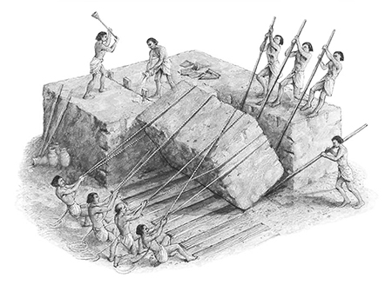


The history of construction embraces many other fields like structural engineering, Civil engineering, cities growing and Population growth that are relatives to branches of Technology science, history, and architecture to investigate the buildings conservation and recorded their accomplishments. Those fields permit use to analyze modern or Latest construction and prehistoric constructions, as their structures, building Materials, and tools used.

Slide 4
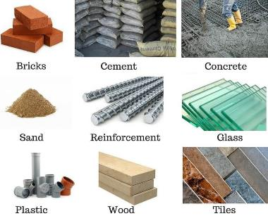
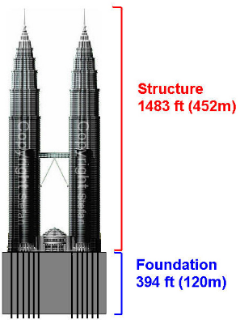
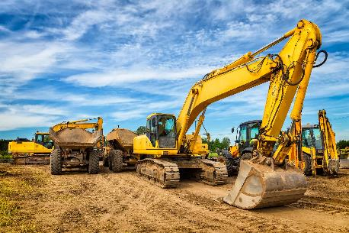
History of building is evolving by different trends in time, marked by few key principles : durability of the materials used, the increasing of height and span, the degree of control exercised over the interior environment and finally the energy available to the construction process.

Slide 5





XVII - XVIII centuries
Middle-age century
Renaissance
Chronological development
Neolithic construction
Copper Age and Bronze Age construction
Iron Age construction
Nineteenth Century: The Industrial Revolution
Academic discipline

Slide 6
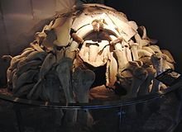
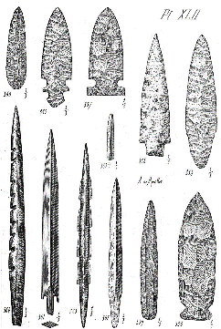
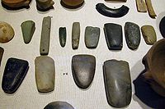
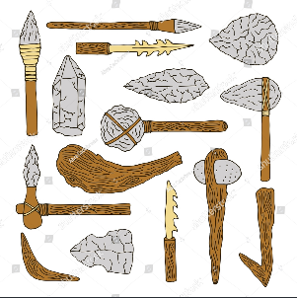
Neolithic construction
The Neolithic, also known as the "New Stone Age", was a time period roughly from 9000 BC to 5000 BC named because it was the last period of the age before wood working began. The tools available were made from natural materials including bone, hide, stone, wood, grasses, animal fibers, and the use of water. These tools were used by people to cut such as with the hand axe, chopper, adze, and celt. Also to scrape, chop such as with a flake tool, pound, pierce, roll, pull and leaver.

Slide 7
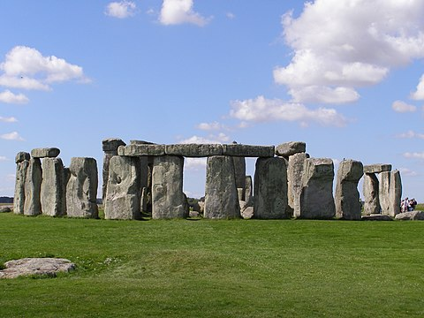
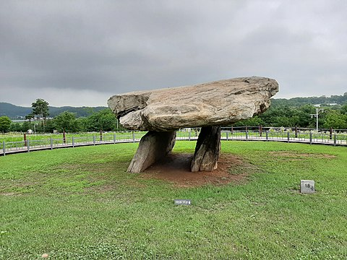
Neolithic architecture ranged from tents to megaliths (large stone formations) and rocky architecture with temples, tombs, and dwellings. The most notable Neolithic structure in Western Europe is the symbolic megalith known as Stonehenge, which demonstrates the methods of wooden construction by some archaeologists, such as Woodhenge.

Slide 8
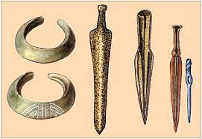
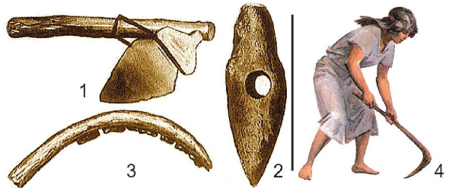
Copper Age and Bronze Age construction
The Copper Age is the early part of the Bronze Age. Bronze is made when tin is added to copper, and brass is copper with zinc. Copper came into use before 5,000 BC and bronze around 3,100 BC, although the times vary by region. Copper and bronze were used for the same types of tools as stone such as axes and chisels, but the new, less brittle, more durable material cut better. Bronze was cast into desired shapes and if damaged could be recast. A new tool developed in the copper age is the saw. Other uses of copper and bronze were to "harden" the cutting edge of tools such as the Egyptians using copper and bronze points for working soft stone including quarrying blocks and making rock-cut architecture.

Slide 9
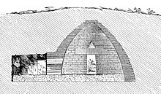
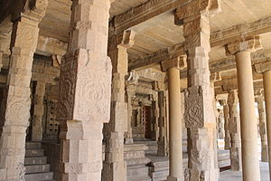
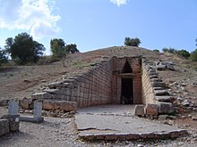
During the Bronze Age the corbelled arch came into use such as for beehive tombs. The wheel came into use but was not common until much later. Heavy loads were moved on boats, sledges (a primitive sled) or on rollers. The Egyptians began building stone temples with the post and lintel construction method and the Greeks and Romans followed this style.

Slide 10
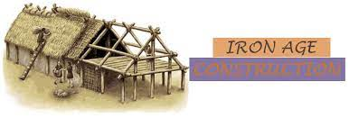
Iron Age construction
The Iron Age is a cultural period from roughly 1200 BC to 50 BC with the widespread use of iron for tools and weapons. Iron is not much harder than bronze but by adding carbon iron becomes steel which was being produced after about 300 BC. Steel can be hardened and tempered producing a sharp, durable cutting edge. A new woodworking tool allowed by the use of steel is the hand-plane.

Slide 11




Materials
The chief building material was the mud-brick, formed in wooden moulds similar to those used to make adobe bricks. Bricks varied widely in size and format from small bricks that could be lifted in one hand to ones as big as large paving slabs. Rectangular and square bricks were both common. They were laid in virtually every bonding pattern imaginable and used with considerable sophistication. Drawings survive on clay tablets from later periods showing that buildings were set out on brick modules. By 3500 BC, fired bricks came into use and surviving records show a very complex division of labour into separate tasks and trades. Fired bricks and stone were used for pavement.
Egyptian stonework
Ishtar Gate
(575 BC)
Dried bricks
Babylon,the archaeological site in 1932

Slide 12
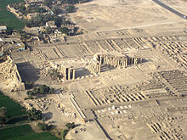
Ancient Egypt
As opposed to the cultures of ancient Mesopotamia which built in brick, the pharaohs of Egypt built huge structures in stone. The arid climate has preserved much of the ancient buildings.
Materials
Adobe (sun-baked mud brick) construction was used for ancillary buildings and normal houses in ancient times and is still commonly used in rural Egypt. The hot, dry climate was ideal for mud-brick, which tends to wash away in the rain. The Ramesseum in Thebes, Egypt (Luxor) provides one of the finest examples of mud brick construction. Extensive storehouses with mud-brick vaults also survive, all constructed with sloping courses to avoid the need for formwork.

Slide 13
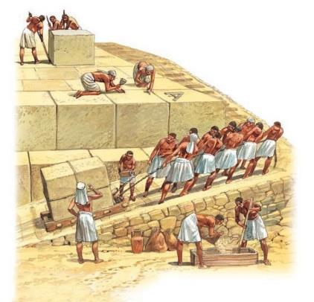
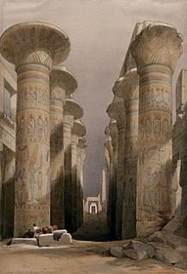
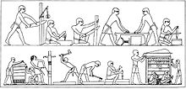
Adobe (sun-baked mud brick) construction was used for ancillary buildings and normal houses in ancient times and is still commonly used in rural Egypt. The hot, dry climate was ideal for mud-brick, which tends to wash away in the rain. The Ramesseum in Thebes, Egypt (Luxor) provides one of the finest examples of mud brick construction. Extensive storehouses with mud-brick vaults also survive, all constructed with sloping courses to avoid the need for formwork.
The grandest buildings were constructed in stone, often from massive masonry blocks. The techniques used to move massive blocks used in pyramids and temples have been subject to extensive debate. Some authors have suggested that the larger may not be cut stone but fabricated with concrete.

Slide 14
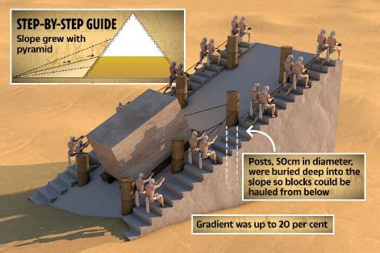

Technology
Although the Egyptians achieved extraordinary feats of engineering, they appear to have done so with relatively primitive technology. As far as is known they did not use wheels or pulleys. They transported massive stones over great distances using rollers, ropes and sledges hauled by large numbers of workers. The ancient Egyptians are credited with inventing the ramp, lever, lathe, oven, ship, paper, irrigation system, window, awning, door, glass, , the bath, lock, shadoof, weaving, a standardized measurement system, geometry, silo, a method of drilling stone, saw, steam power, proportional scale drawings, enameling, veneer, plywood, rope truss, and more. There are no surviving Egyptian manuals so there has been considerable speculation on how stones were lifted to great heights and obelisks erected. Most theories centre on the use of ramps.

Slide 15
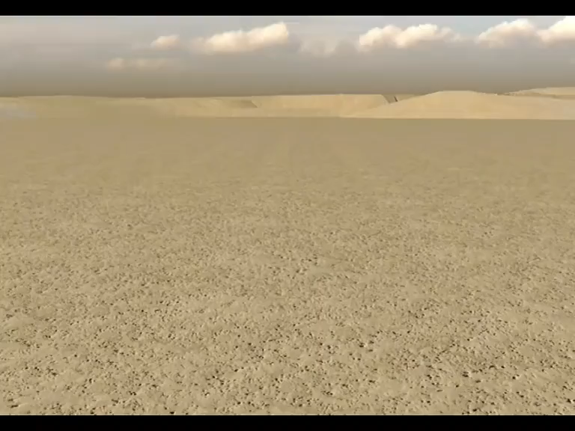

Slide 16
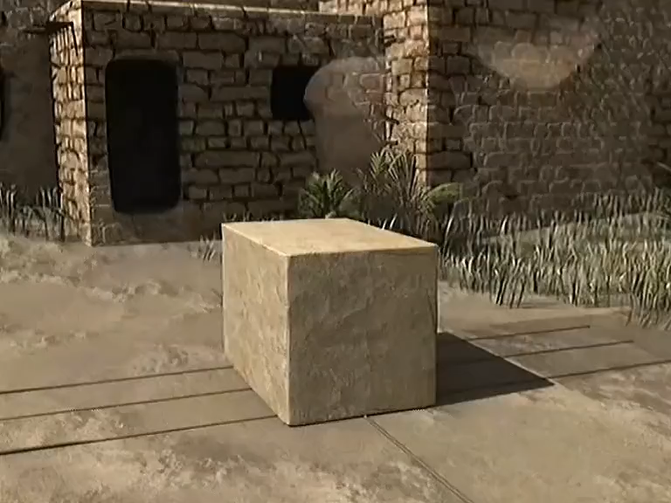

Slide 17
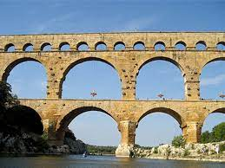
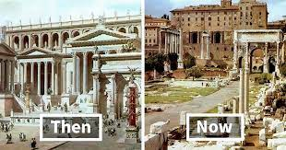
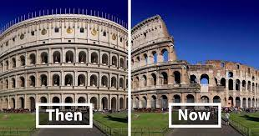
Rome Empire
In striking contrast to previous cultures, an enormous amount is known about Roman building construction. A very large amount survives, including complete intact buildings like the Pantheon, Rome and very well preserved ruins at Pompeii and Herculaneum. We also have the first surviving treatise on architecture by Vitruvius which includes extensive passages on construction techniques.

Slide 18
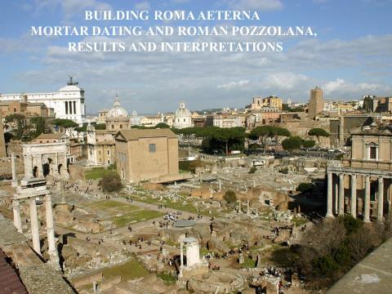
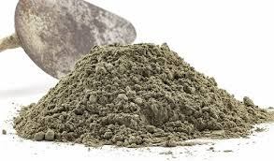
Materials
The great Roman development in building materials was the use of hydraulic lime mortar called Roman cement. Previous cultures had used lime mortars but by adding volcanic ash called a pozzolana the mortar would harden under water. This provided them with a strong material for bulk walling. They used brick or stone to build the outer skins of the wall and then filled the cavity with massive amounts of concrete, effectively using the brickwork as permanent shuttering (formwork). Later they used wooden shuttering that was removed for the concrete to cure.
puzolana

Slide 19
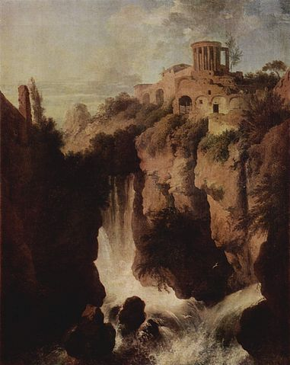
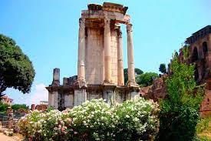
An example of a temple made of Roman concrete in the 1st century BC is the Temple of Vesta in Tivoli, Italy. The concrete was made of nothing more than rubble and mortar. It was cheap and very easy to produce and required relatively unskilled labour to use, enabling the Romans to build on an unprecedented scale. They not only used it for walls but also to form arches, barrel vaults and domes, which they built over huge spans. The Romans developed systems of hollow pots for making their domes and sophisticated heating and ventilation systems for their thermal baths.
Temple of Vesta

Slide 20
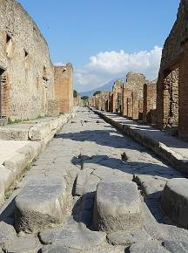
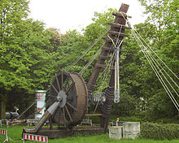

Technology
The invention of the waterwheel, sawmill, and arch were by the Romans. The Romans also began using glass for architectural purposes after about 100 CE and used double glazing as insulated glazing. Roman roads included corduroy roads and paved roads, sometimes supported on raft or pile foundations and bridges. Vitruvius gives details of many Roman machines. The Romans developed sophisticated timber cranes allowing them to lift considerable weights to great heights. The upper limit of lifting appears to have been about 100 tonnes. Trajan's column in Rome contains some of the largest stones ever lifted in a Roman building, and engineers are still uncertain exactly how it was achieved.
korduroy yollar
Roma yolları
Roma maşınları

Slide 21
