Slide 1
I love food.
Notes:
Оригинальные шаблоны для презентаций: https://presentation-creation.ru/powerpoint-templates.html
Бесплатно и без регистрации.

Slide 2
Let’s train the sounds
Tell me, little Pete, [i:] [t] [l] [w]
What you like to eat?
Well, I like to eat,
What is good and sweet!
Give me an orange, [ɔ] [dȝ] [r] [ɪ]
Orange, orange
I don’t like to eat porridge, porridge, porridge!

Slide 3
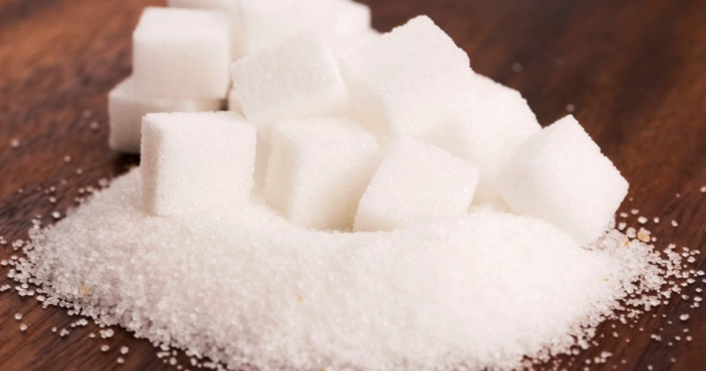
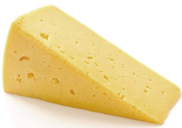
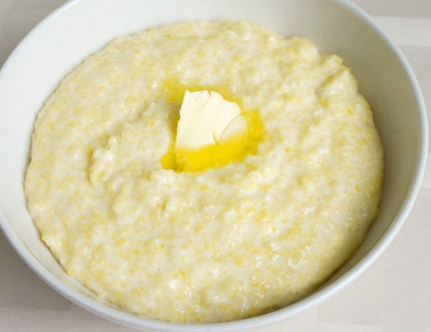
Guess the food!
It is white and sweet. All children like it.
We usually put it into tea.
The mouse likes it very much. It’s yellow in colour.
You can eat it hot for breakfast with milk and sugar.

Slide 4
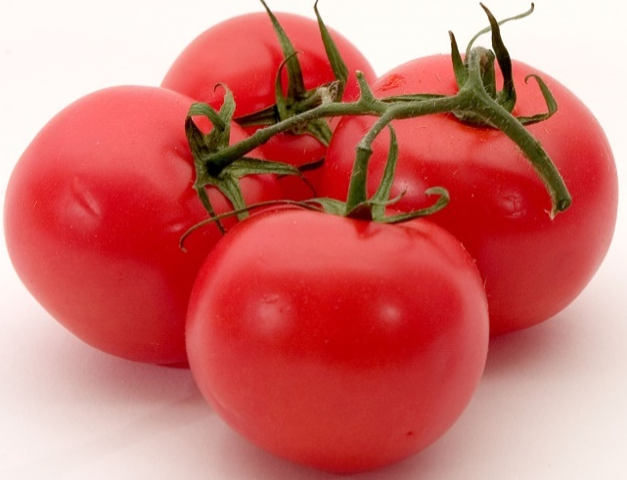
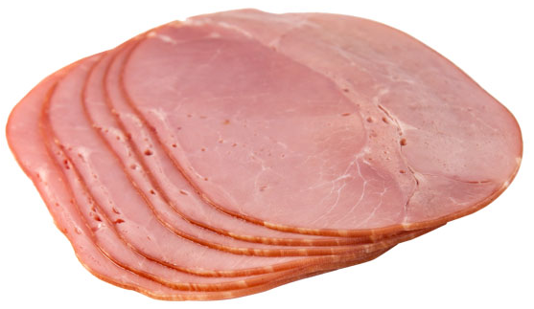
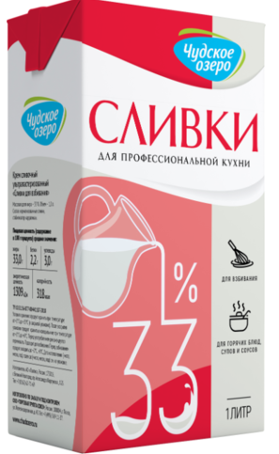
It is red and round.
We make salad from it.
You put it in your sandwich. Its colour is pink. You can make salad with it.
Its colour is white. It’s made of milk,
we can add it to coffee or tea.

Slide 5
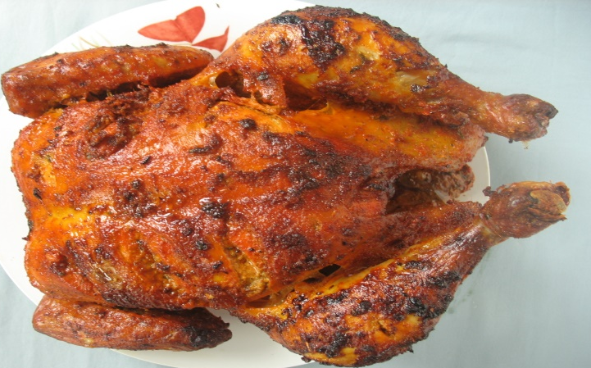
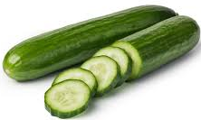
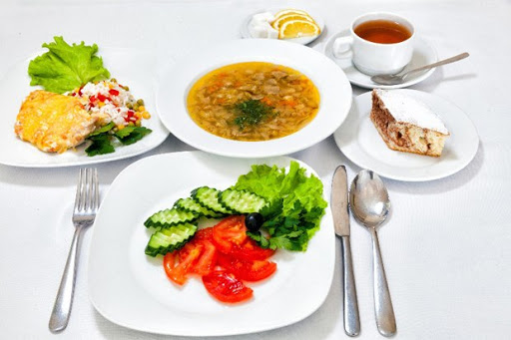
New words
chicken – цыпленок, мясо [ˈtʃɪkɪn] курицы
1
2
cucumber – огурец
[ˈkjuːkʌmbə]
3
4
5
dinner – обед
[ˈdɪnə]

Slide 6
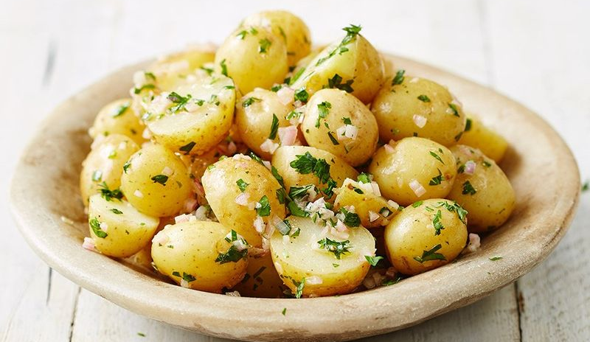
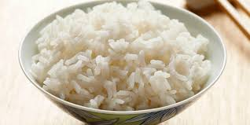

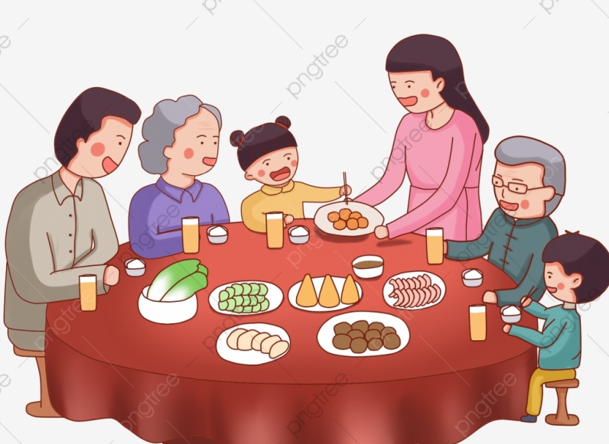
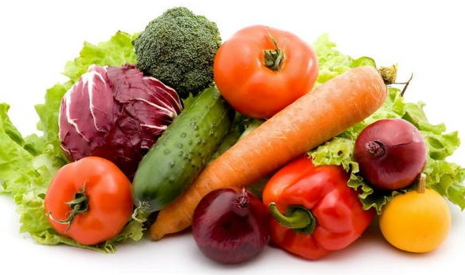
potato – картофель
[pəˈteɪtəʊ]
rice – рис
[raɪs]
supper – ужин
[ˈsʌpə]
vegetables –овощи
[ˈvedʒɪtəbəlz]

Slide 7
Make the words! Составь слова!
chi
tato
ce
po
tables
din
ner
cucum
cken
per
ber
sup
ri
vege

Slide 8
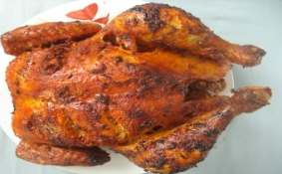




Fill in the sentences.
My mum is making sandwiches.
I like tomato and salad.
What would you like for ?
I like and fish for my supper.
and is my favourite dish.
are good for supper.

Slide 9
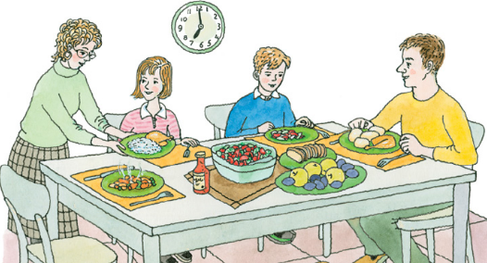
What are they eating?
The Barkers are having …
John is eating …
Mr. Barker is eating …
Mrs. Barker is eating …
Sally is eating …

Slide 10
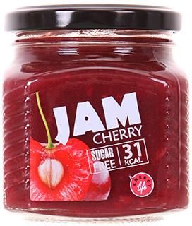

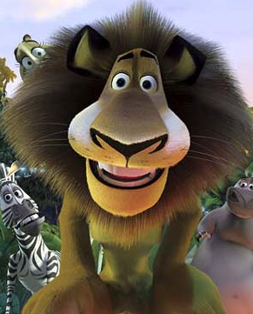
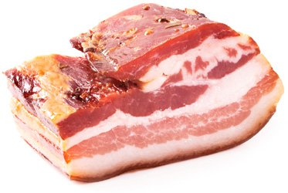
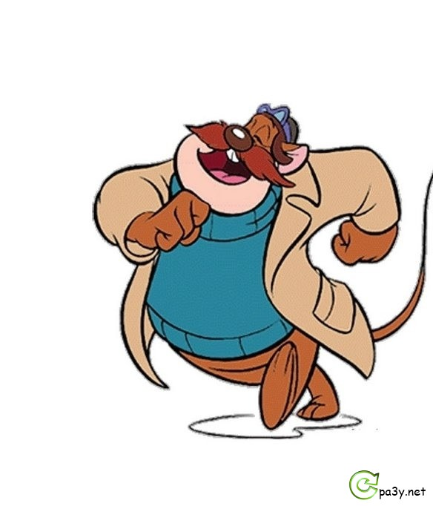
I would like …- Мне бы хотелось…

Slide 11
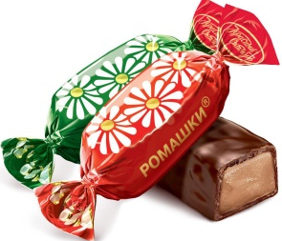

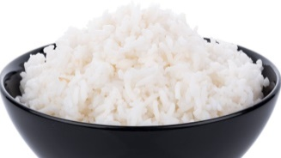

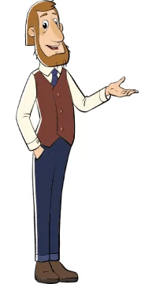
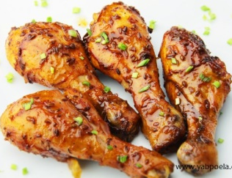
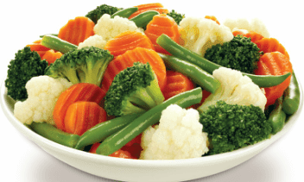
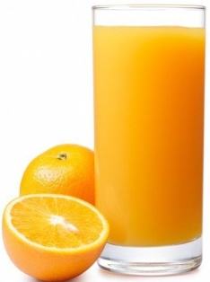

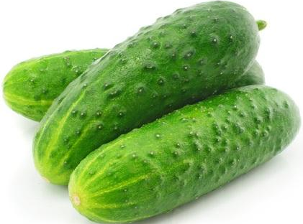
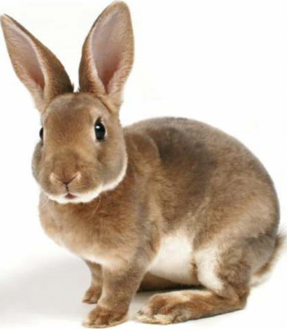

What would they like?
Чего бы им хотелось?

Slide 12

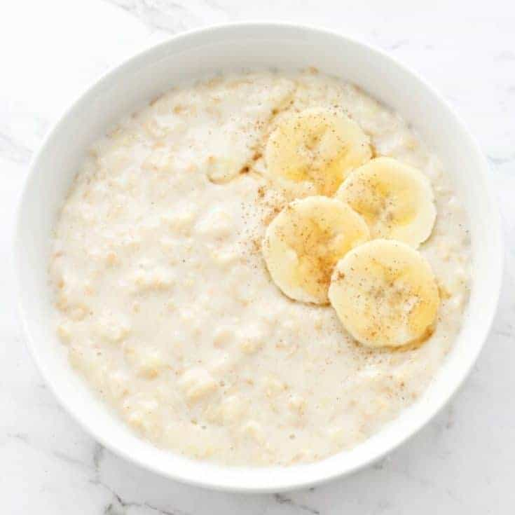
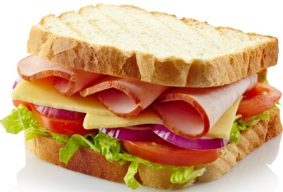
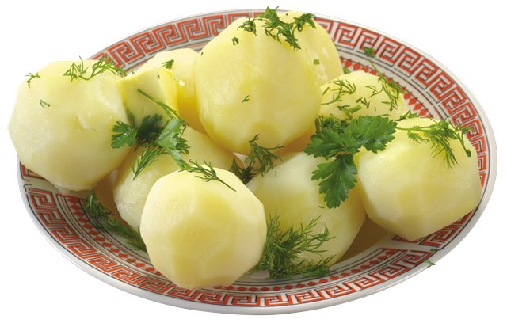
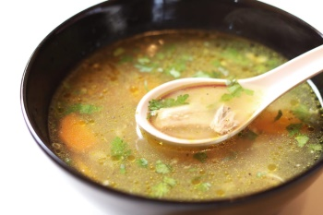
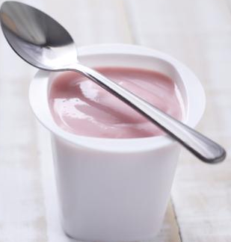
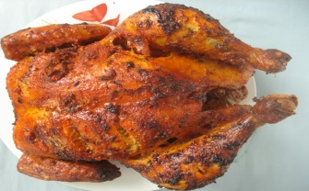
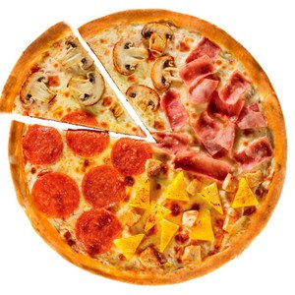
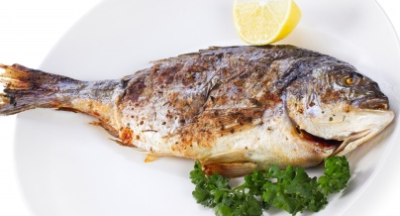
Work in pairs! – работаем парами.
What would you like?
… for breakfast?
завтрак
… for dinner?
обед
… for supper?
ужин

Slide 13
Рефлексия
Do you enjoy the lesson?
Тебе понравился урок?
зеленый –
урок понравился, трудностей при выполнении заданий не возникло
желтый – возникли некоторые затруднения при выполнении отдельных заданий
красный – материал урока показался сложным

